Slide 1
Plein Air Painting & Australian Impression
-
In other Australian States and overseas
Andrea Hope
www.australianarthistory.com

Slide 2
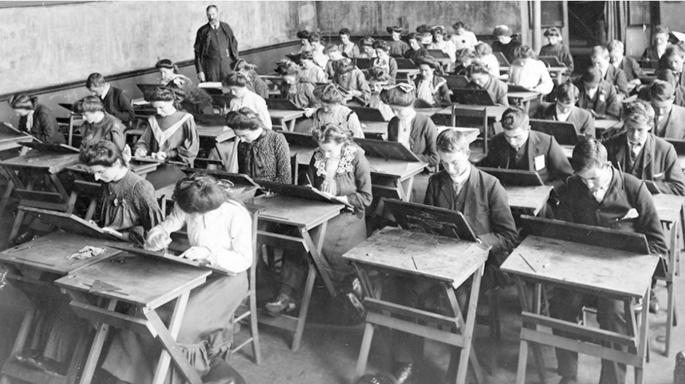
The National Gallery of South Australia opened in 1881.
In 1882 the Board of Governors of the South Australian Institute (from 1884 the Public Library, Museum and Art Gallery of South Australia) appointed H.P. (Henry Pelling) Gill as master of the school of design (later known as School of Design and Painting), where he influenced a shift to painting plein air.
Besides his work as a teacher and lecturer, Gill founded the Adelaide Art Circle limited to 12 professional artists. Its exhibitions were dominated by Gill's work.

Slide 3
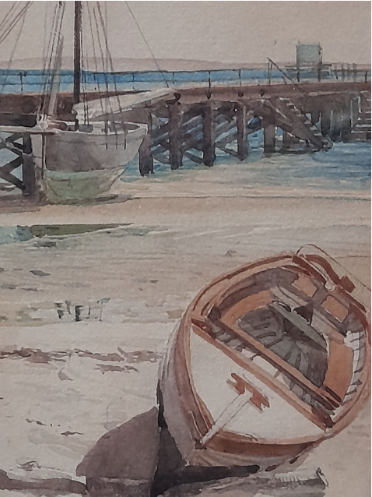
Gill's landscapes and some of his interiors show that he was interested in the accurate rendering of light—a rare quality in Adelaide before 1900.
He was appointed honorary curator of the Art Gallery of South Australia, and was also responsible for purchasing works of young Australian artists such as Tom Roberts, Hans Heysen, Frederick McCubbin, Louis Buvelot, Sydney Long, John Longstaff, Walter Withers, William Lister Lister and Blamire Young.
His students included Hans Heysen, Millicent Hambidge and Margaret Preston
H P Gill, Moored boats with Jetty, Port Lincoln, 1903

Slide 4
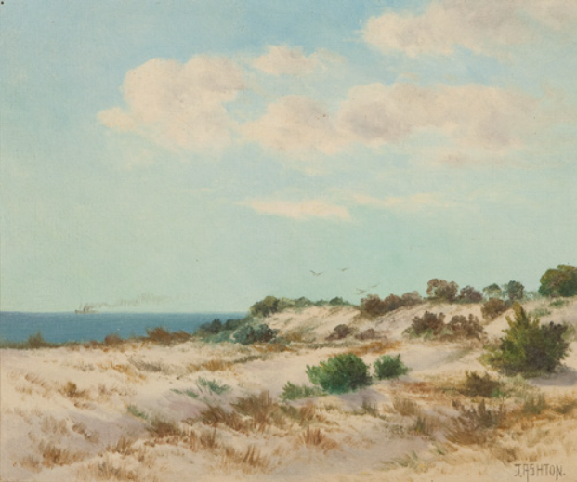
James Ashton (1859 – 1935)
Ashton emigrated to Adelaide in 1884 and established the Norwood art school in 1886.
He visited England in 1894, studied under Henry Moore, R.A. and was elected a member of the Royal Society of Arts. Returning to Adelaide in 1895 he founded the Academy of Arts, and for over 30 years was the best known teacher of painting in South Australia.
He was an art teacher at Prince Alfred College for nearly 40 years, president of the South Australian Society of Arts for four years and a founding member and longtime president of the Adelaide Easel Club.
Among his pupils were Ivor Hele, Hans Heysen, Hayley Lever, Frank White, Arthur Baker-Clack, & his son Will Ashton.
James Ashton, Sand Dunes

Slide 5
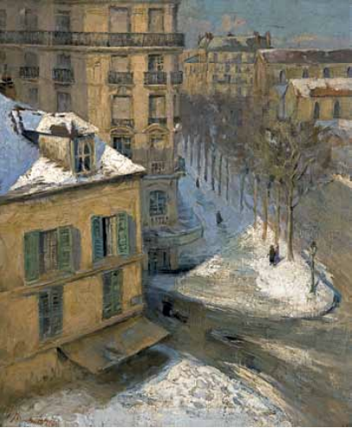
Hans Heysen (1877 – 1968)
In 1899, Hans Heysen, a promising 22 year old art student. arrived in Paris. He lived in a hotel in the very heart of Montparnasse.
From the apartment window, Paris, 1901,is painted in a high-key with fluid strokes of paint, and depicts the view from his fifth-floor room looking west along the tree-lined boulevard - the kind of elevated urban view pioneered by the Impressionists.
Heysen’s interest in Impressionism was noted back in Adelaide, with one newspaper reporting that ‘Mr. Hans Heysen has been working very hard in Paris, where his style has been becoming more and more assimilated to that of the French impressionist school’.
Hans Heysen, From the apartment window, Paris, 1901

Slide 6
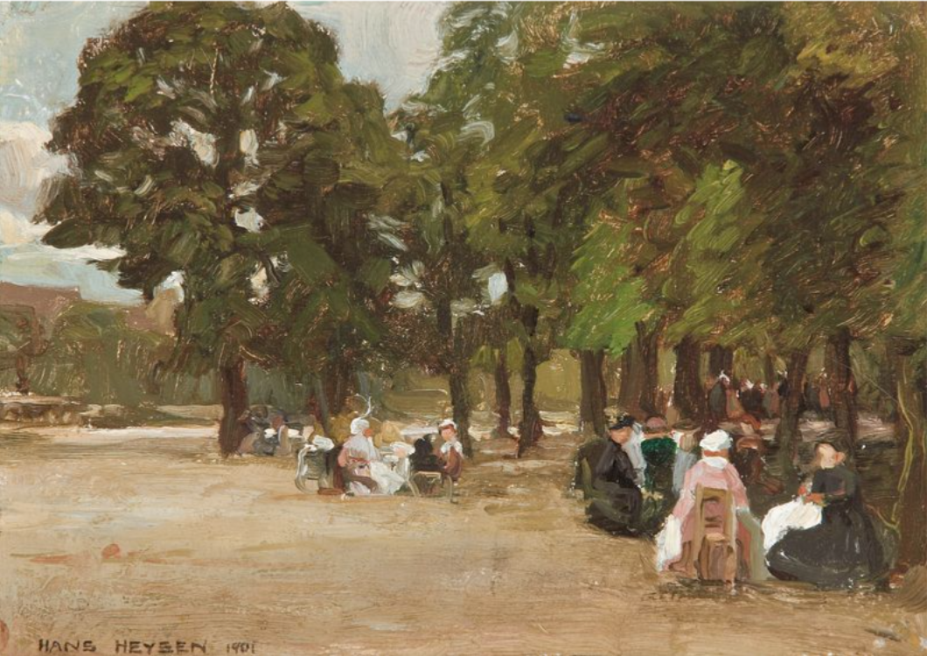
Hans Heysen, In the Luxembourg Gardens, Paris, 1901

Slide 7
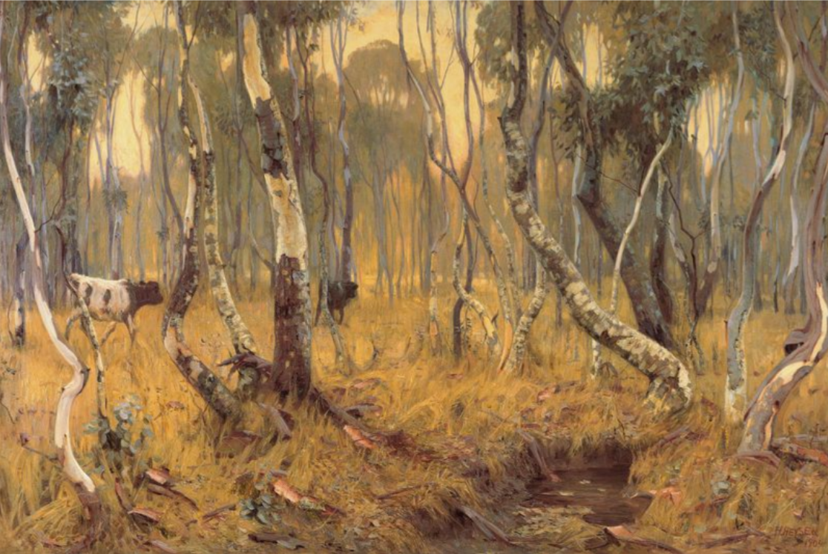
In Paris, Heysen attended the Académie Julian and Colarossi’s Academy, and was invited to join the Ecole des Beaux Arts. There were also summer painting excursions to Holland and Scotland, and a hasty visit to Germany and in 1903 he travelled through Italy before returning to Adelaide.
He later reported that the impact of Australian light as he sailed up St Vincent's Gulf was like a slap in the face, profoundly affecting his attitude and vision. Almost at once he turned his back on Europe and concentrated on Australian landscape.
Heysen was awarded the Wynne Prize an unprecedented nine times between 1904 and 1932.
Hans Heysen, Mystic Morn, 1904

Slide 8
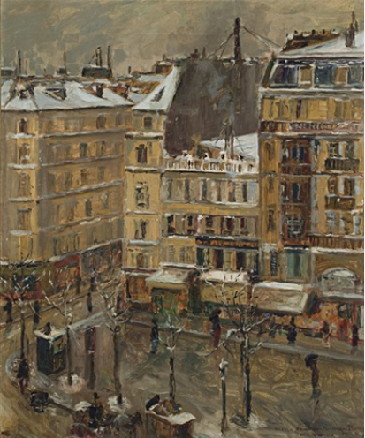
John William (Will) Ashton (1881-1963)
In 1900 Will Ashton left for England to work under the seascapist Julian Olsson at St Ives, Cornwall.
He spent the winter of 1902-03 at the Académie Julian, Paris, with E. Phillips Fox, David Davies and Hans Heysen.
In 1904 he had work accepted by the Royal Academy of Arts, London, and the Salon de la Société des Artistes Français, Paris
His painting 'Boulevard Montparnasse, Paris' was sold for 150 guineas to the Art Gallery of South Australia.
Will Ashton, Boulevard Montparnasse, Paris, 1902/3

Slide 9
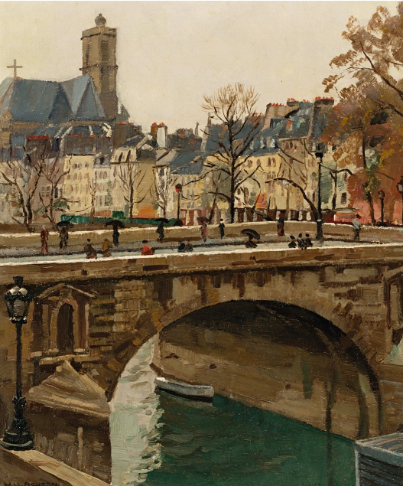
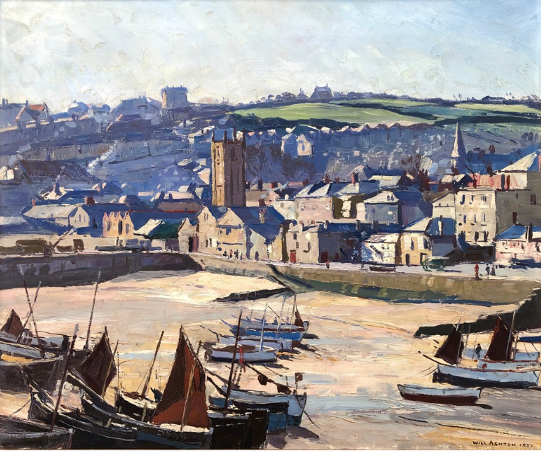
Ashton made frequent overseas trips, returning again and again to Paris and England.
Will Ashton, St Ives
Will Ashton, Pont Neuf

Slide 10
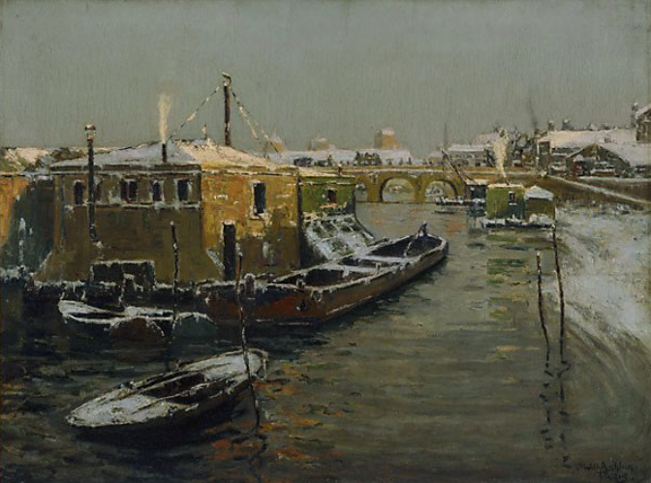
Apart from his formal studies Ashton sketched at weekends in Paris streets or on the banks of the River Seine. His first great success was in 1904 when two works, The Wreck and Reed Waters, were exhibited at the Royal Academy.
He had a long and successful career as both artist and administrator and was the Director of AGNSW from 1937 – 44.
Will Ashton, A Winter's Eve, Paris, 1900 (AGNSW)

Slide 11
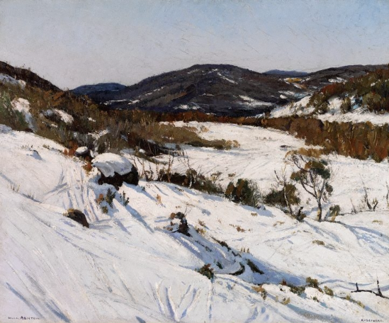
Ashton won the Wynne prize for landscape three times.
Will Ashton, Kosciusko, 1930

Slide 12
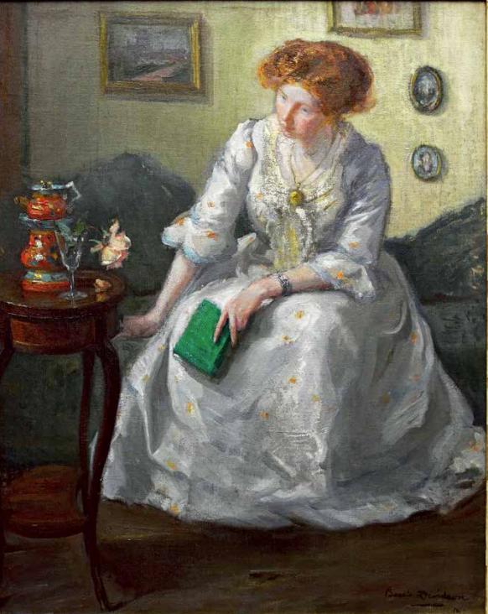
Bessie Ellen Davidson (1879–1965)
Davidson studied art in 1899 in Adelaide under Rose McPherson (Margaret Preston) and exhibited with the South Australian Society of Arts in 1901-03.
In 1904 Davidson departed for Europe with McPherson and studied briefly at the Künstlerinner Verein, Munich, Germany.
They moved to Paris in November where she studied at the Académie de la Grande Chaumière.
Travelling frequently, she painted en plein air, often taking a small paintbox.
Jessie Davidson, The Green book, (Le Livre vert), 1912

Slide 13
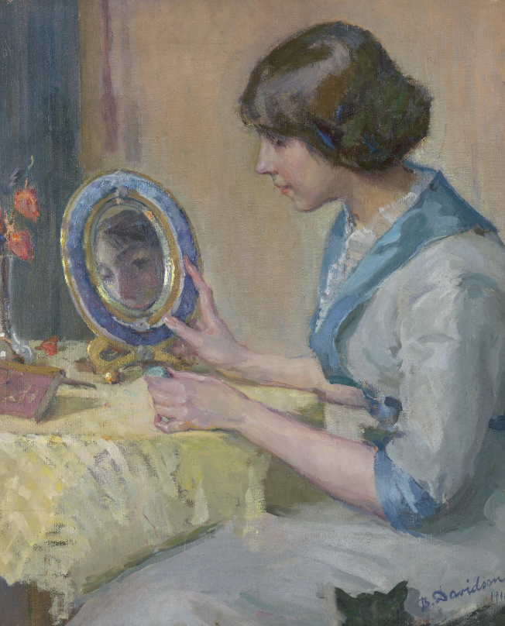
Bessie Davidson, Jeune Fille au Mirror, c 1914

Slide 14
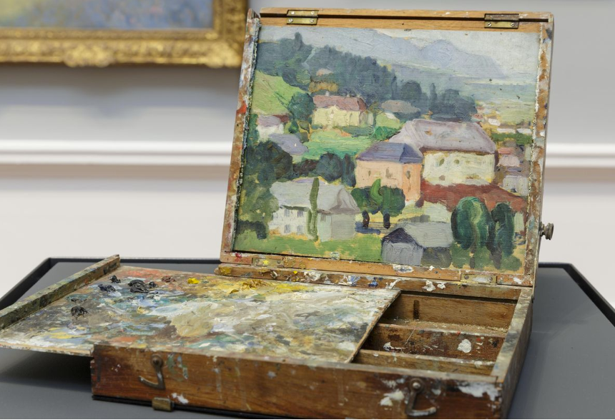
As early as 1905 she was included in Paris' Salon exhibitions - she exhibited her 'Petite Marie' at the Salon de la Société des Artistes Français; in 1906 two of her paintings were shown at the Société Nationale des Beaux-Arts. She became a founding member of and exhibited with the Salon des Tuileries.
Back in Adelaide, Davidson leased a studio with Preston and they held a combined show in 1907.
Davidson exhibited regularly with the South Australian Society of Arts, with still lifes, portraits and landscapes.
Bessie Davidson, portable paintbox

Slide 15
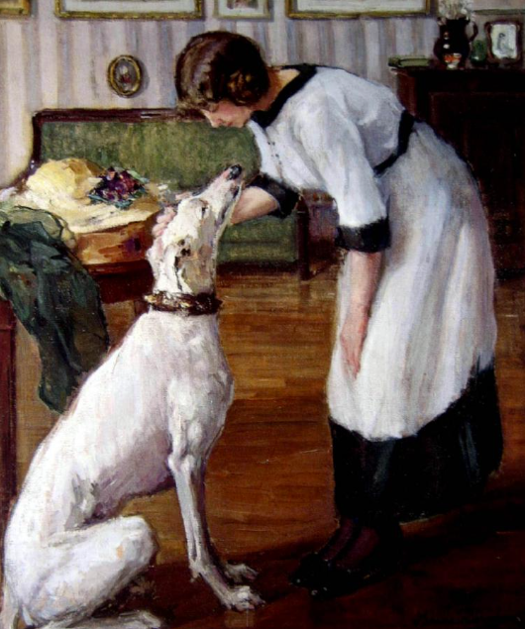
In 1908, the Art Gallery of South Australia bought her portrait of her friend Gladys Reynell.
Davidson returned to Paris in 1910, exhibited annually, and travelled through Europe and Russia.
During this period Davidson and Preston also travelled to Morocco and French Algiers to experience the exotic culture and lifestyle of the Orient.
Bessie Davidson, Jeune Femme et Levrier, 1913

Slide 16
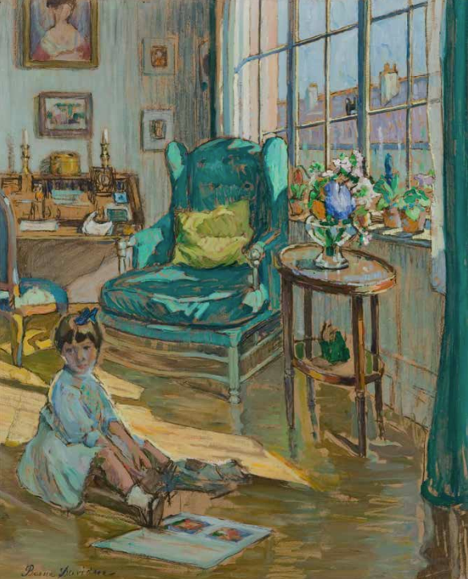
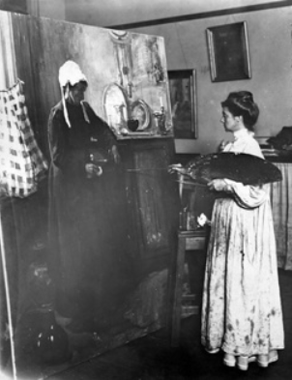
She was appointed Chevalier de la Légion d’Honneur for Art and Humanity by the French Government in 1931.
Bessie Davidson, at work on 'Old Servant', c.1909
Bessie Davidson, An Interior, c1920

Slide 17
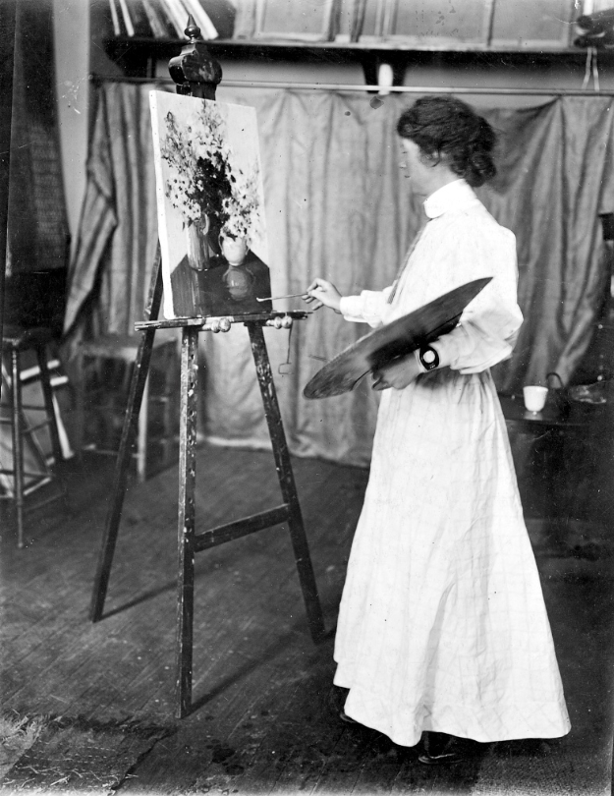
Margaret Rose Preston (1875 –1963)
Born Margaret Rose Macpherson in Adelaide, Preston studied with landscape painter Lister Lister in Sydney from 1888, at the National Gallery of Victoria schools in Melbourne in 1893-94 and 1896-97 (under McCubbin), and at the Adelaide School of Design in 1898 under H.P. Gill and Hans Heysen, focusing on still life rather than figure studies.
She travelled to Europe in 1904, studying for three years in Munich and Paris, and made a longer second trip in 1912, where she saw the post-Impressionist exhibition organised by Roger Fry in London.
She exhibited paintings at the New Salon in Paris and the Royal Academy and the New English Art Club in London.
Margaret Preston in her Studio c 1909

Slide 18
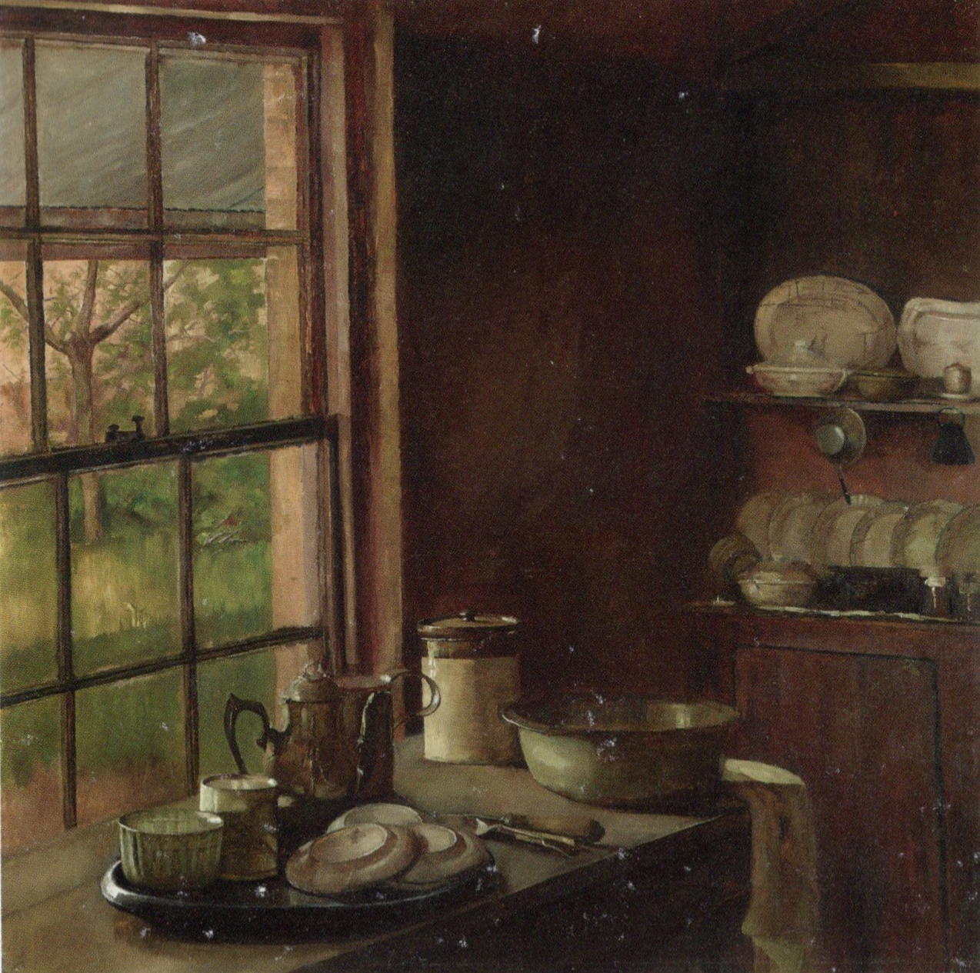
Preston’s traditional oils were accepted by the Salon de la Société des Artistes Français.
Margaret Preston, Cottage Kitchen, 1905

Slide 19
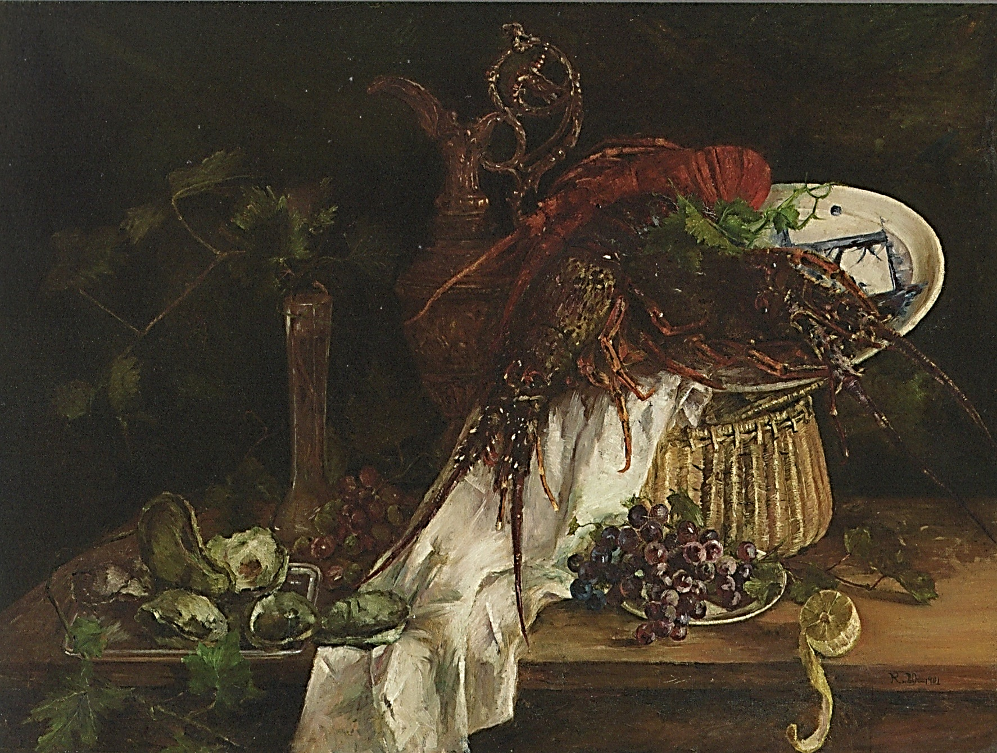
Margaret Preston, Still Life, Lobster, 1901

Slide 20
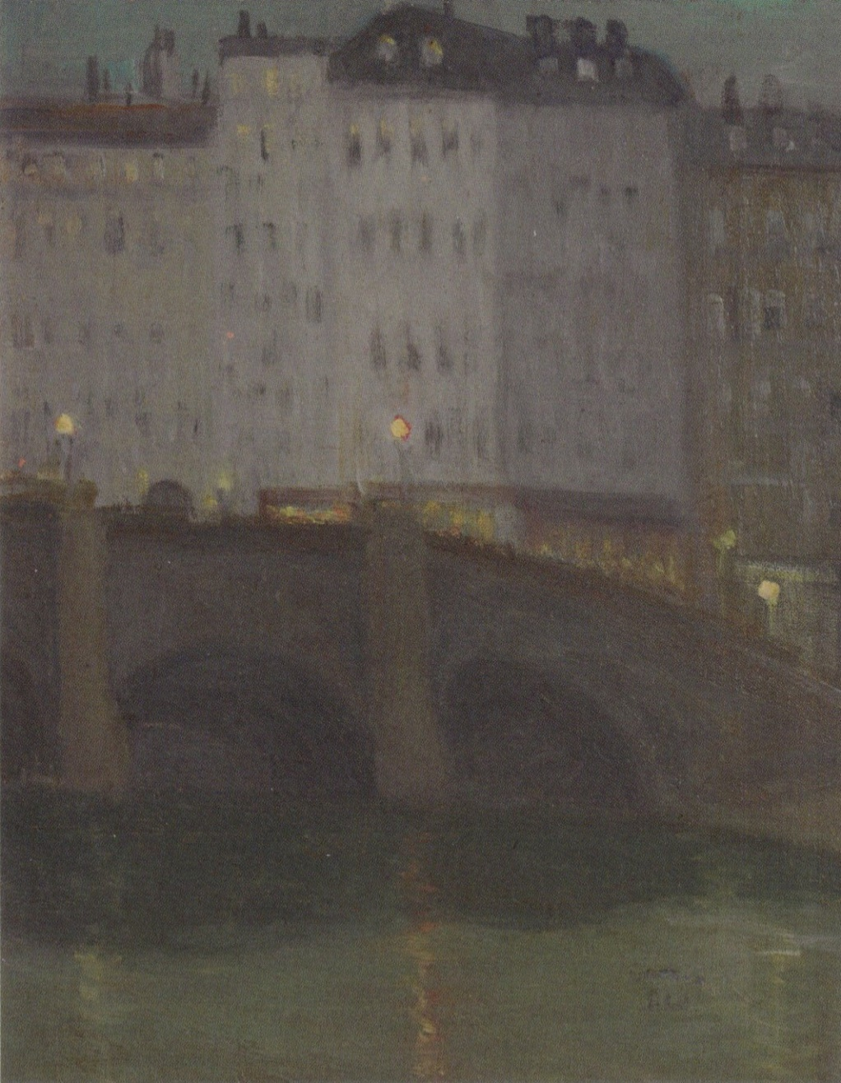
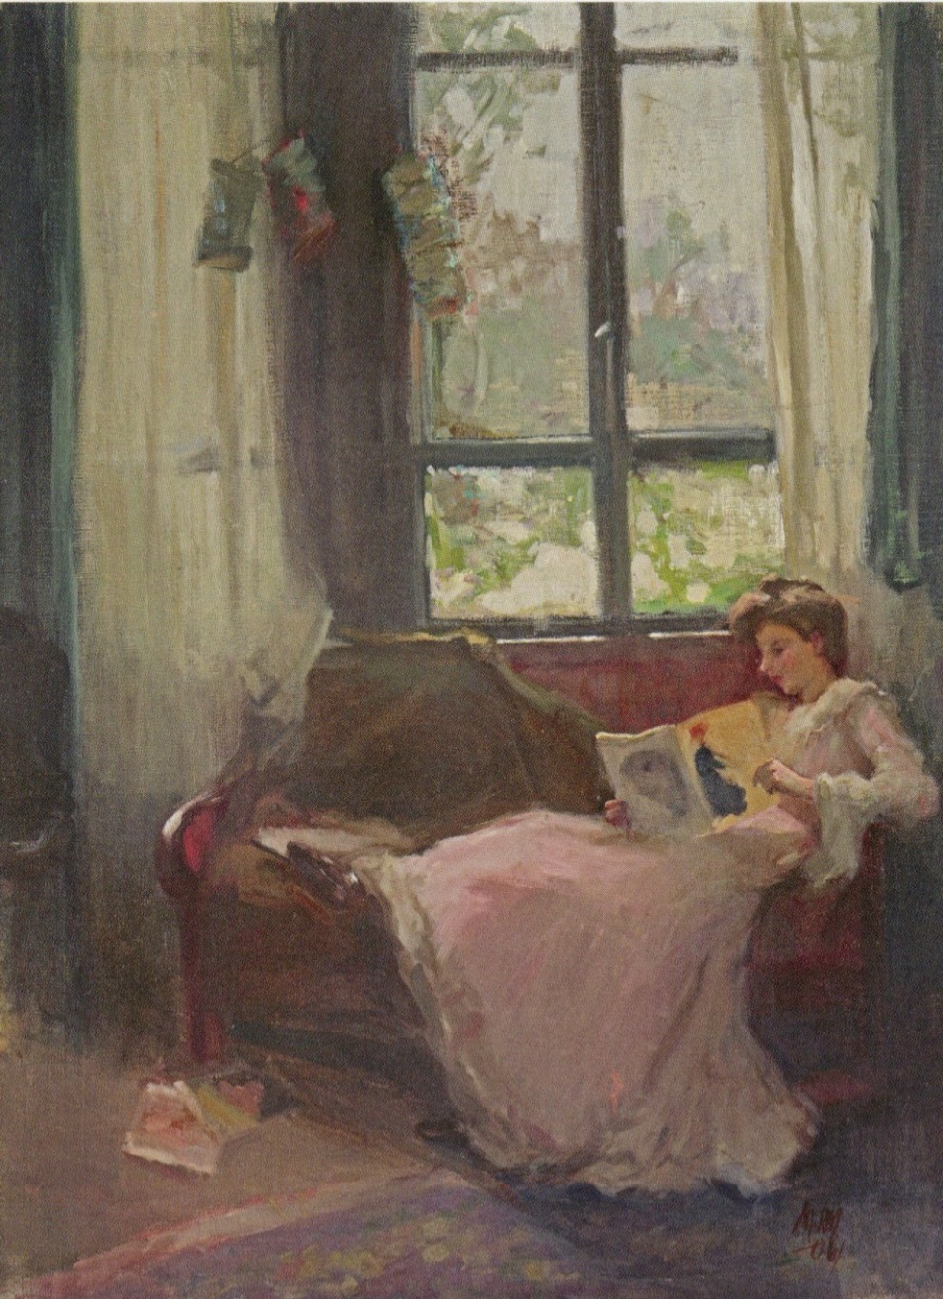
Margaret Preston, Night Sketch, c1906
Margaret Preston, The Studio Window, 1906

Slide 21
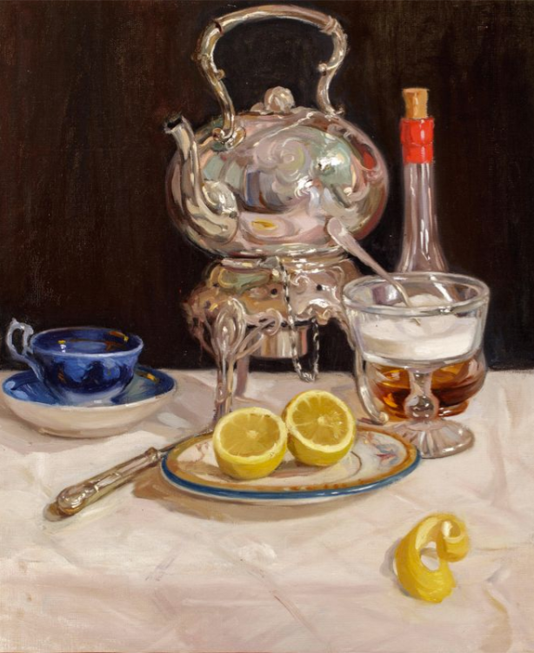
Preston taught in Adelaide from 1899 to 1904 and again from 1907 to 1912.
Her concentration on tonalism in her early work influenced the art of her students, the most notable of whom were Bessie Davidson, Stella Bowen, May Grigg and Gladys Reynell.
Her still-life The tea urn (c. 1909) is typical of this style of painting.
Margaret Preston, The Tea Urn, c 1909

Slide 22
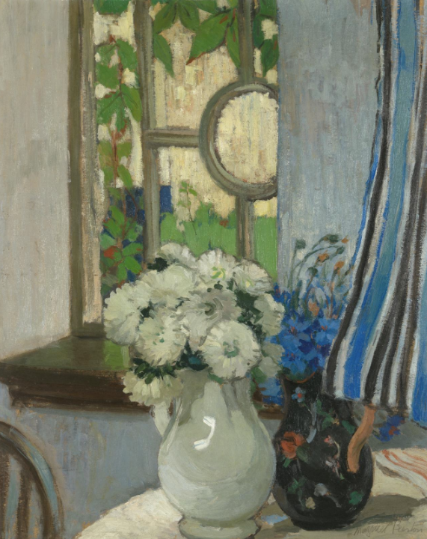
In Europe, she studied Japanese and Chinese art at the Musée Guimet, learning 'slowly that there is more than one vision in art’.
After seeing works by artists such as Matisse, van Gogh, Cézanne, Gauguin and Whistler, and the influences of oriental aesthetics, Preston developed a ‘decorative’ style that she would carry through her entire oeuvre.
Margaret Preston, The Window, c. 1916

Slide 23
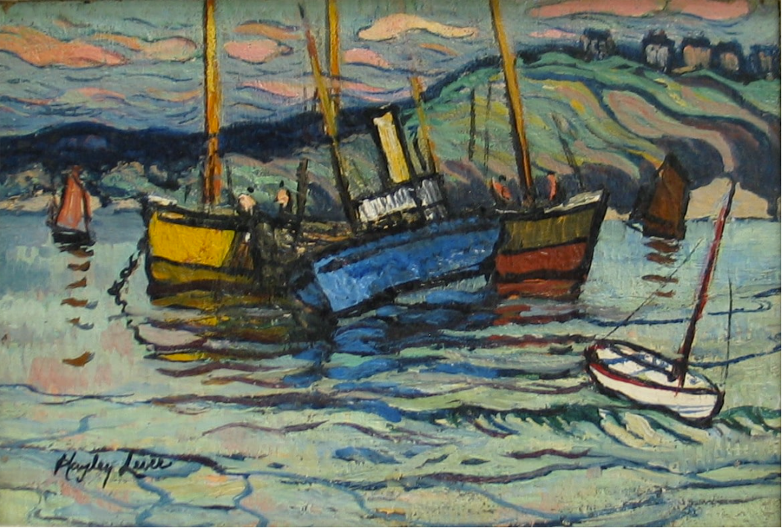
Richard Hayley Lever (1876 –1958)
Lever studied at Prince Alfred College under James Ashton and continued to study under Ashton at his Norwood art school. He was a charter member of the Adelaide Easel Club in 1892.
He moved to St. Ives in 1899 and also painted in the French port villages of Douarnenez and Concarneau, Brittany, directly across the English Channel from St. Ives.
In 1904 he debuted at the Royal Academy of Arts in London.
He had subsequent exhibitions at the St. Ives Art Club, the New English Art Club, the Royal West of England Academy, and the Society of Royal British Artists, as well as in Paris, Nice, and Venice.
Hayley Lever, Fishing Boats, Exmouth, 1905

Slide 24
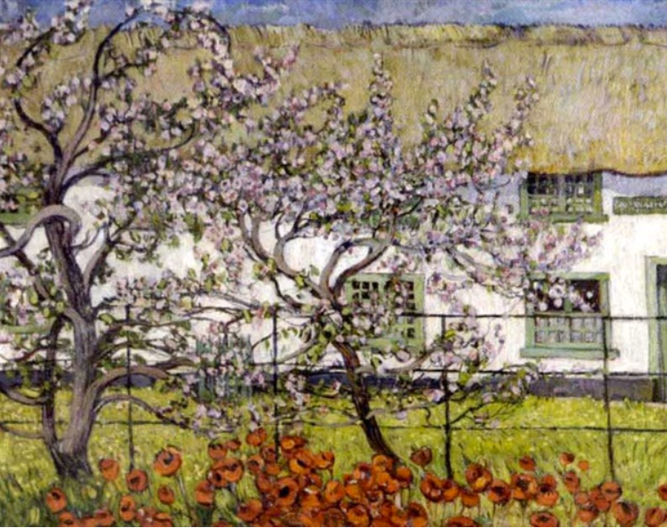
In late 1904 Lever made a trip back to Adelaide, where his mother was dying of tuberculosis. During his twelve-month stay he staged several exhibitions, painted seascapes and taught.
In 1908 Lever first saw the work of Post-Impressionist painter Vincent Van Gogh.
The artist’s boldness in unleashed form and colour, and the flat two-dimensional shapes and patterns, inspired Lever.
Lever did a series of paintings called Van Gogh's Hospital, Holland expressing the profound influence he felt.
Hayley Lever, Van Gogh's Hospital, 1908

Slide 25
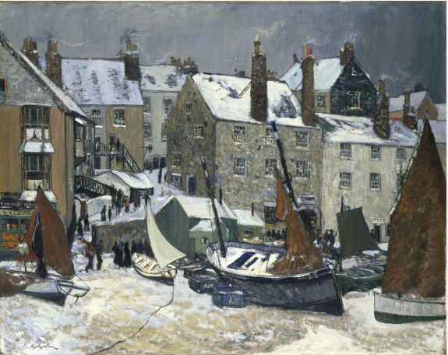
Lever later settled permanently in America.
Hayley Lever, Winter, St Ives, c1914

Slide 26
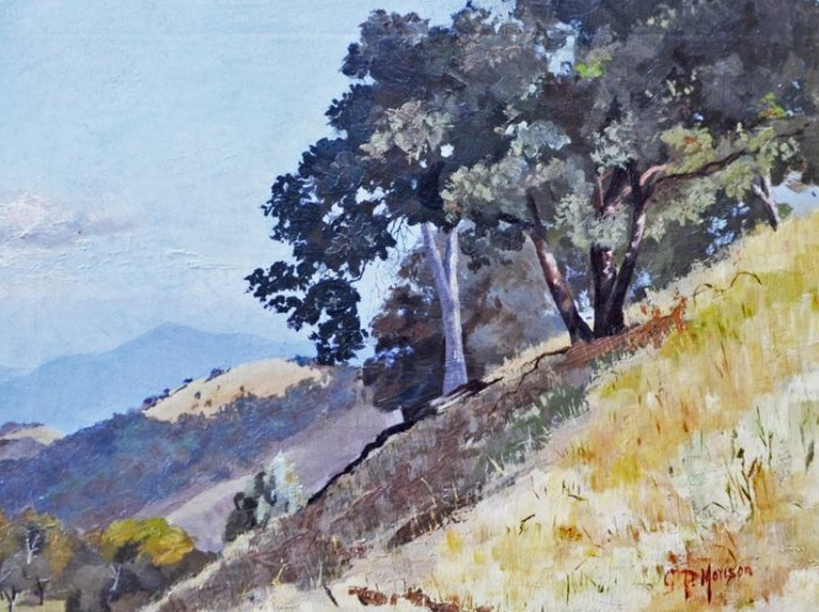
Western Australia
With the formation of the Wilgie Sketching Club in 1889, plein air painting became popular among Western Australia’s artists.
The Economic Depression of the 1890s encouraged a number of artists with experience in Australian Impressionism in Victoria and NSW to seek financial opportunities in Western Australia.
Principal among these artists was George Pitt Morison (1861 - 1946), who had studied at the National Gallery of Victoria School and painted at the artists’ camps.
George Pitt Morison, Hillside

Slide 27
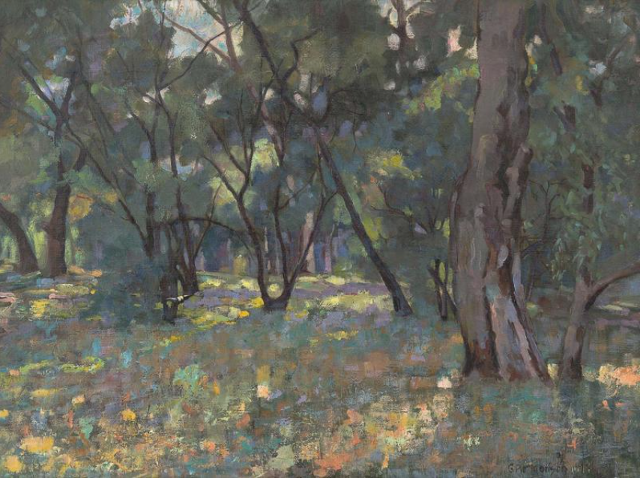
In 1890, an inheritance enabled him to study in Paris at the Académie Julian, where he became friends with E. Phillips Fox and Tudor St George Tucker, and American Impressionists who encouraged him to paint at the artists’ colonies in Etaples and along French Coast.
George Pitt Morison, Dappled Sunlight

Slide 28
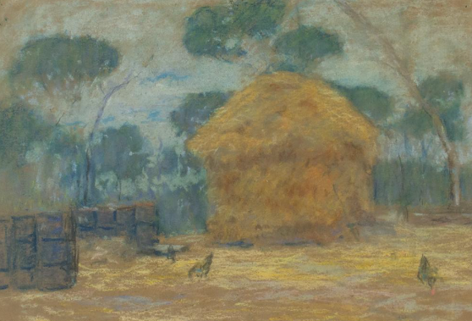
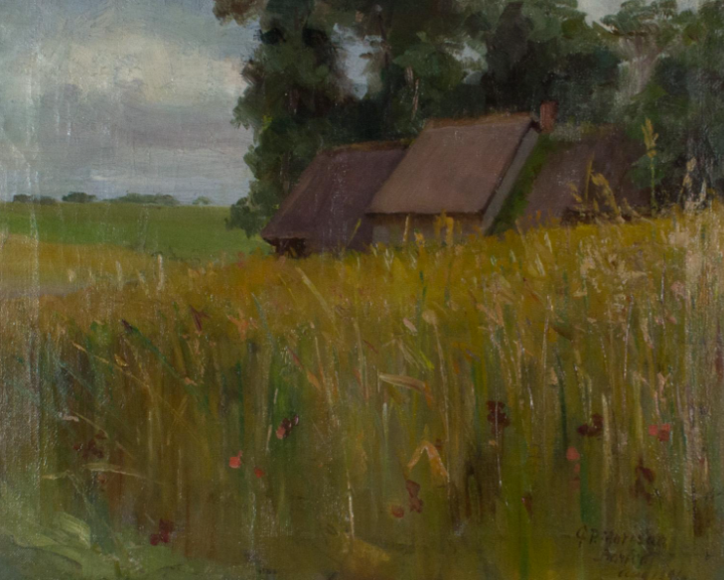
After returning to Melbourne in 1893, Morison moved to Fremantle in 1894 where he was appointed an assistant in art at the Public Library, Perth, in 1906 and later appointed curator of Art and Arts & Crafts at the Museum and Art Gallery of Western Australia. He was a key figure in establishing the Perth
Technical School.
George Pitt Morison, Farmyard with Haystack
George Pitt Morison, French Landscape

Slide 29
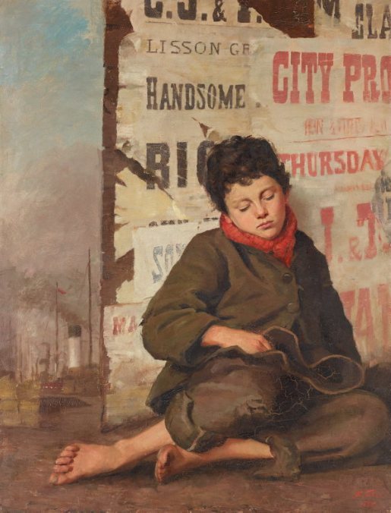
Florence Ada Fuller (1867–1946), immigrated as a child to Melbourne where she studied at the National Gallery School, and worked as a governess before opening a studio specialising in portraits in 1886.
Three years later, she won the prize for the best portrait by an artist under 25 at the inaugural exhibition of the Victorian Artists' Society.
Florence Fuller, Weary, 1888

Slide 30
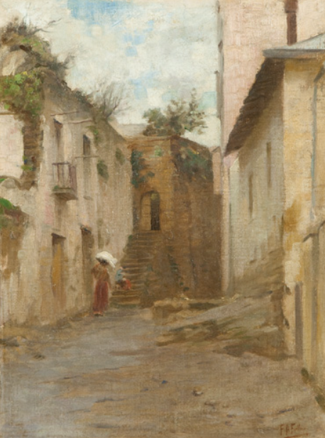
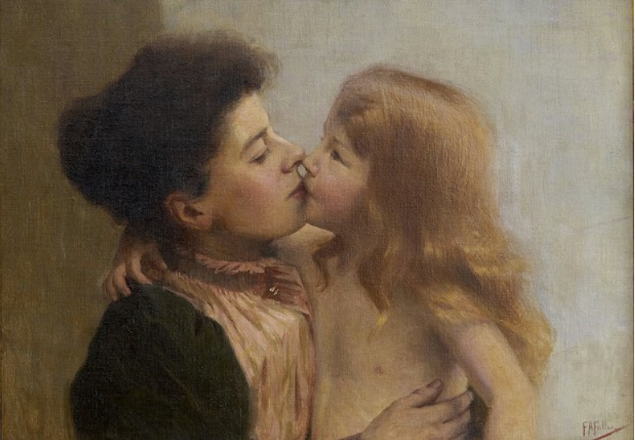
In 1892, Fuller spent two years living with family in the Cape of Good Hope and then for the next decade, she lived in England and Europe, studying at Académie Julian until 1901 and exhibiting at the Paris Salon, Royal Academy and the Royal Institute of Oil Painters.
Florence Fuller, Corner in Naples
Florence Fuller, Mother and Child

Slide 31
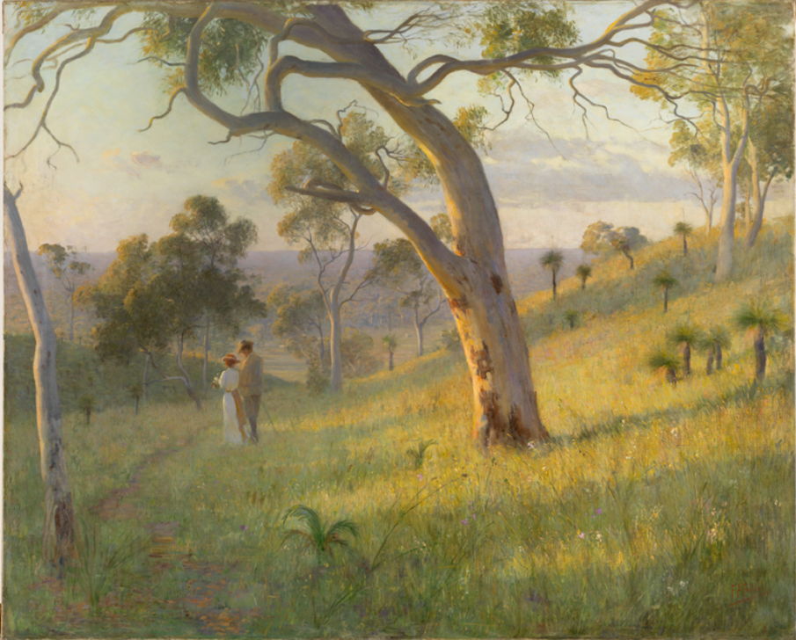
On her return to Australia in 1904 she moved to Perth, where she painted portraits and her 1905 masterpiece A Golden Hour, now in the National Gallery of Australia collection. Fuller also showed with the WA Society of Arts and taught pupils including Kathleen O'Connor.
Florence Fuller, A Golden Hour, 1905

Slide 32
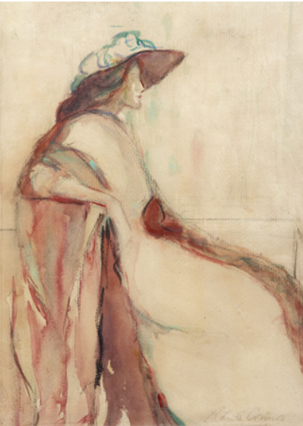
Kathleen Laetitia "Kate" O'Connor (1876 – 1968)
O’Connor was educated in Wellington NZ, and by private tuition in Perth from 1891, including lessons from artist Florence Fuller.
She exhibited with the Western Australian Society
Of Arts before working briefly in Sydney
as a decorator.
O’Conner sailed for Europe in 1905 and in London she studied at the Bushey School of Art under von Herkomer, Brangwyn and Marmaduke Flower.
Kathleen O'Connor, Portrait of Francis Hodgkins

Slide 33
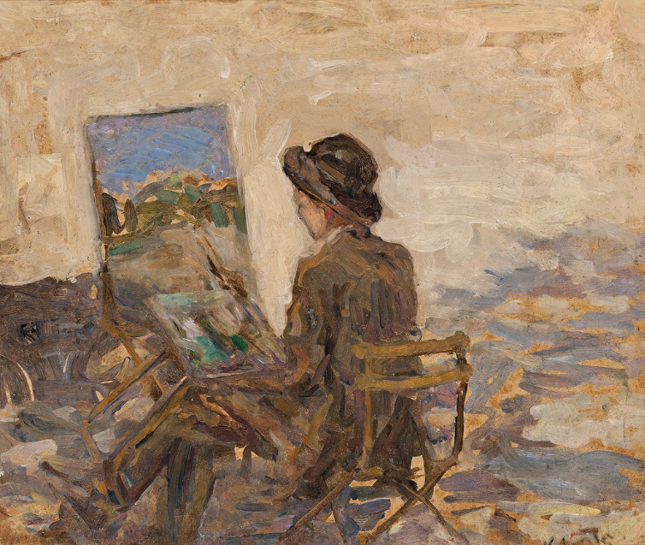
O’Connor settled in Paris, relishing its bohemianism, subsisting on a monthly allowance of £8. She wrote about her Parisian experiences for Perth newspapers.
She attended night classes, and learned 'by looking at pictures and listening to discussions and criticisms' and by attending galleries and lectures.
In 1911 she worked with Frances Hodgkins at her school of watercolour in Paris and at Concarneau, a fishing port.
She exhibited in the Salons d' Automne (1911-32), des Independants, and de la Société des Artistes Français.
Kathleen O'Connor, Artist and Easel, Luxembourg Gardens, C.1910-14

Slide 34
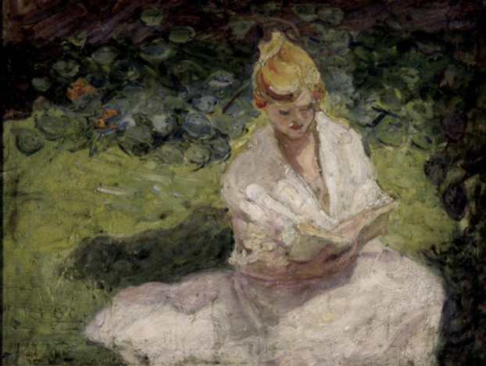
She moved to London in 1914 and exhibited with the International Society of Sculptors, Painters and Gravers in 1915 and the National Portrait Society in 1916, returning to Paris that year. She travelled between Europe and Australia (particularly as a result of WWII) from 1940.
Kathleen O'Connor, Young Girl in a Garden, 1920

Slide 35
Notes:
Kathleen O’Connor, In the Studio, c 1928

Slide 36
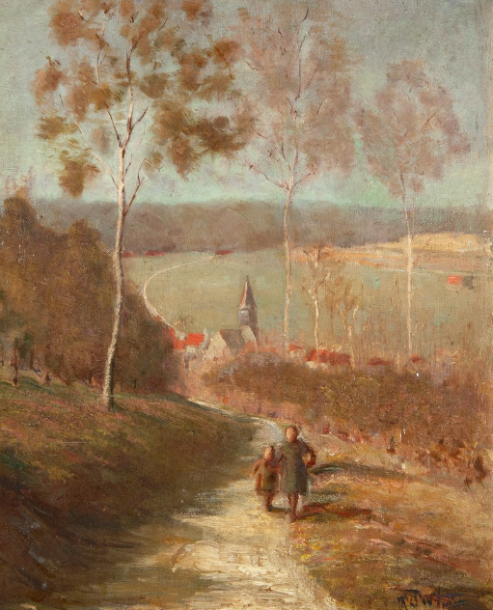
Duncan McGregor Whyte received his artistic training at Glasgow before studying at the State School at Antwerp under Pieter van Havermaet and at Paris’s Académie Delecluse.
Duncan McGregor Whyte, Going Home

Slide 37
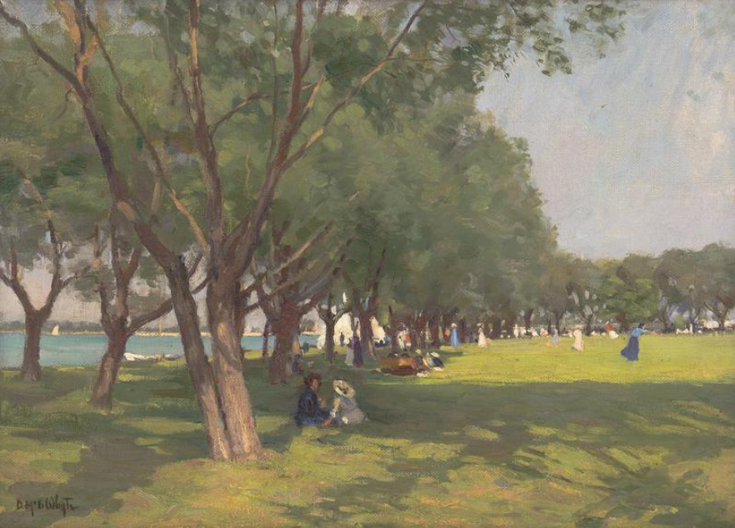
Following his studies Whyte travelled to Australian in, settling in Perth for nearly five years, where he was President of the Western Australian Society of Arts from 1920-21, before returning to Scotland in1923.
Duncan McGregor Whyte, Perth Foreshore

Slide 38
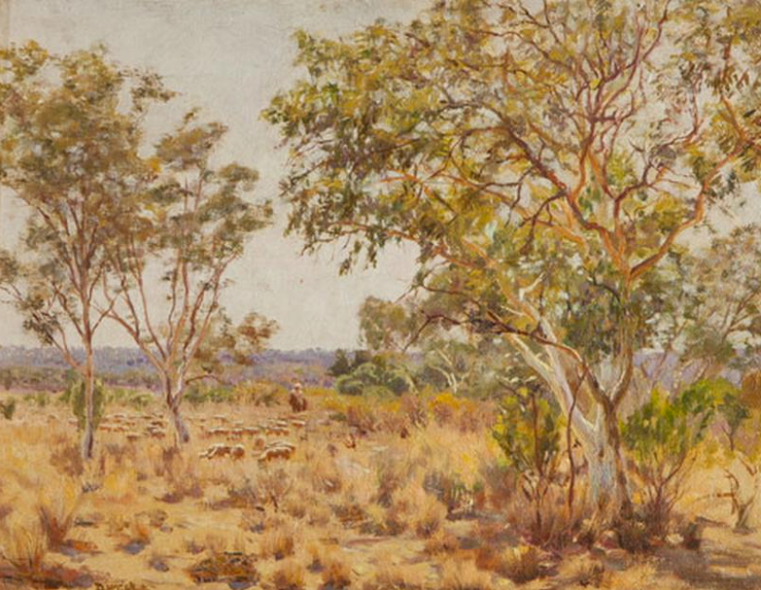
While in Western Australia, Whyte was associated with James Linton and John Horgan and also taught “Outdoor Painting Classes in Oils and Watercolours” at Leederville, Perth.
Duncan McGregor Whyte, Landscape with Sheep and Horseman, c1920

Slide 39
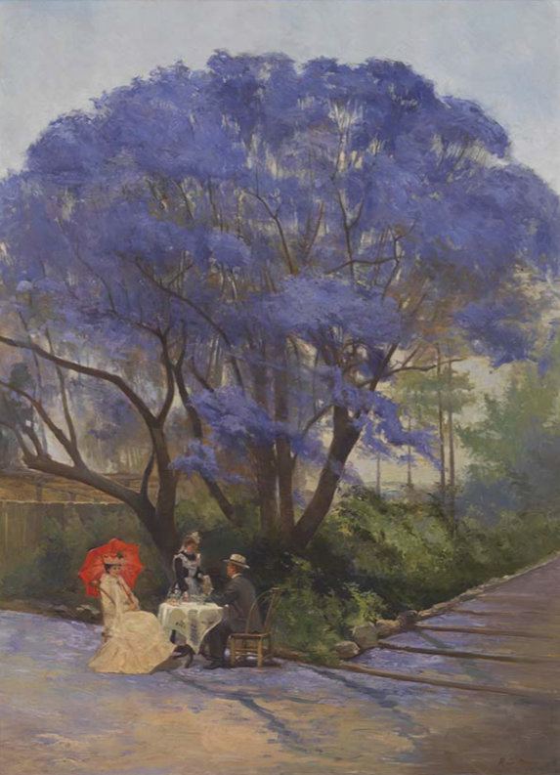
Queensland
Richard Godfrey Rivers (1858-1925) studied at the Slade School of Fine Art, University College, London under Professor Alphonse Legros, receiving the prize for landscape painting in 1883 and exhibiting at the Royal Academy of Arts in 1884.
In 1889 he came to Australia where he taught in NSW, before being appointed second art master at Brisbane Technical College in 1890.
He soon emerged as leader of Brisbane's artistic community and the first artist member of the Queensland Club in 1891.
R Godfrey Rivers, Under the Jacaranda Tree, 1903

Slide 40
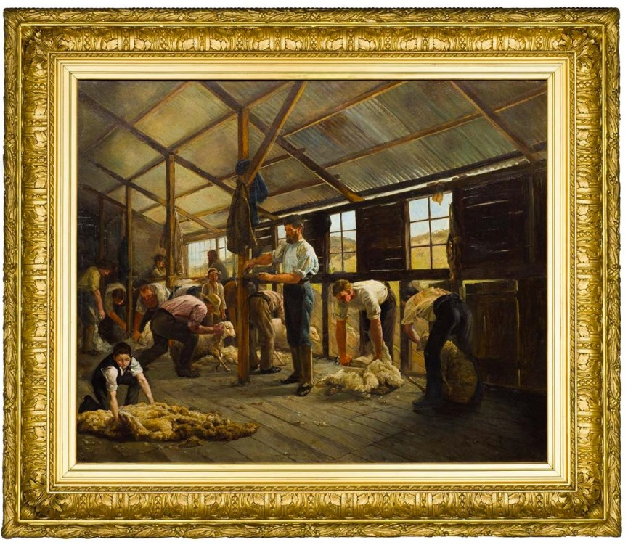
Rivers also taught at his studio, at the Brisbane High School for Girls and at Brisbane Girls' Grammar School; his students included Bessie Gibson, Vida Lahey and Harold Parker.
Rivers was president of the Queensland Art Society in 1892-1901 and 1904-08.
It was largely through his efforts the Queensland National Art Gallery ultimately opened in 1895; the opening exhibition was hung by him and included his 'Woolshed New South Wales' (1890).
R Godfrey Rivers, Woolshed, NSW, 1890

Slide 41
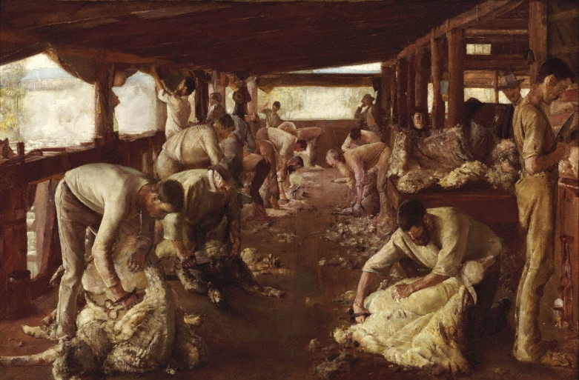

Slide 42
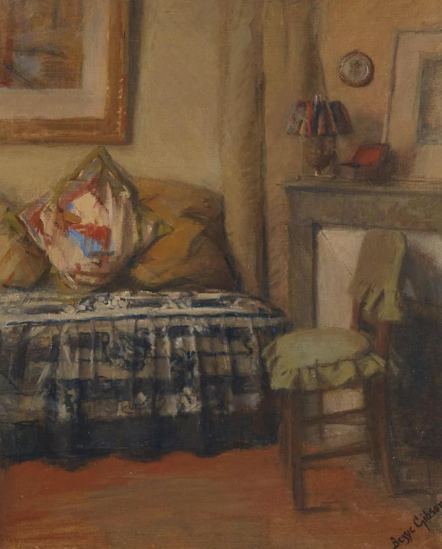
Elizabeth Dickson (Bessie) Gibson (1868-1961) studied art at Brisbane Technical College
in 1899-1905 under Godfrey Rivers.
In 1901-02 she visited relatives in Scotland and was inspired to study abroad.
She left for Paris in 1905, living in Montparnasse, where she remained until 1939, with some visits home.
Bessie Gibson, Corner of my Studio in Paris

Slide 43
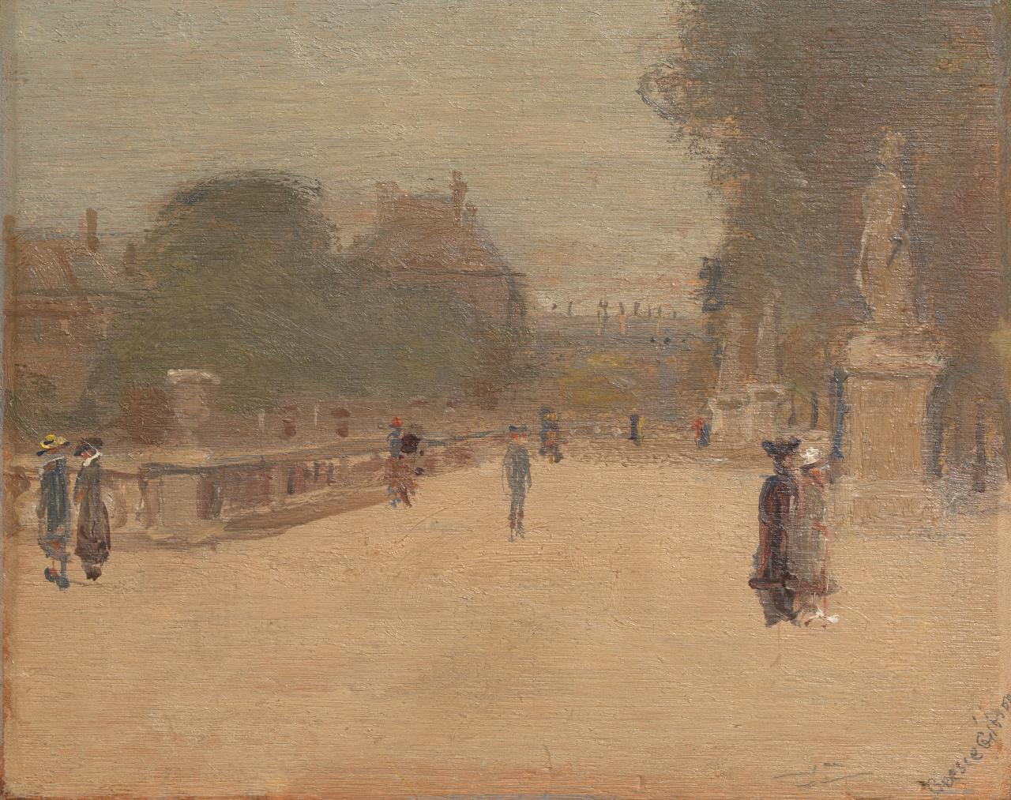
Never part of the avant-garde, she maintained close friendships with fellow expatriates and remained firmly in the conservative world of the Royal Academy and Salon exhibitions.
Studying principally at the Castelucho and Colarossi ateliers under Frances Hodgkins and the American Edwin Scott, she also briefly studied miniature painting, at which she excelled, under Mlle Debillemont-Chardon.
Bessie Gibson, Luxembourg Gardens, early 1910s

Slide 44
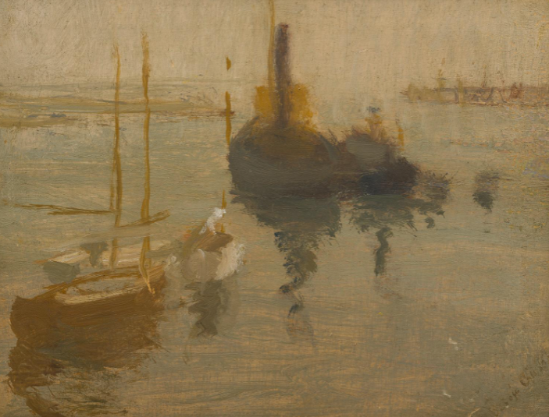
Gibson's work included miniatures of family or friends, formal portrait studies in oils, Whistlerian études on wooden panels of Paris, Honfleur and Cherbourg; and watercolours of portraits, landscapes or interiors.
Bessie Gibson, Sydney Harbour

Slide 45
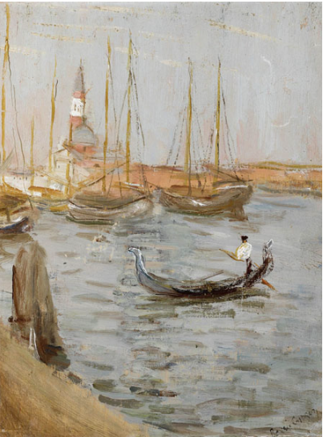
After 1913 Gibson exhibited almost annually at either the Société des Artistes Français or the Salon d'Automnes until 1939.
She won an honorable mention from the former in 1924 and a bronze medal at the International Exposition for Miniatures, 1937.
After spending the war years in England, she returned to Australia in 1947 and began to exhibit in Sydney and Melbourne.
Her work is now in several State galleries, the National Gallery of Australia and in private collections.
Bessie Gibson, Venice on the Grand Canal

Slide 46
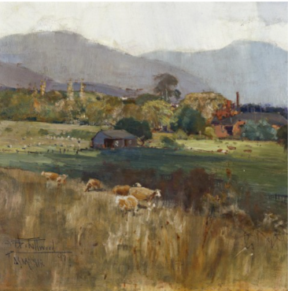
TASMANIA
In 1889 an art gallery opened in connection with Tasmanian museum, and the Hobert Technical college took over teaching function of one of Australia’s oldest art institutions, the Van Dieman’s Land Mechanics School of Art.
In 1890s A Henry Fullwood visited Tasmania where he taught students plein air practices.
During a 1897 interview on ‘The Impressionist School of Painting’ in which a reviewer from Mercury newspaper stated Tasmania was 'seized with a frenzy of impressionism’.
Fullwood was described as being ‘busy with his brush and with teaching’.
A Henry Fullwood, New Town, Hobart, 1897

Slide 47
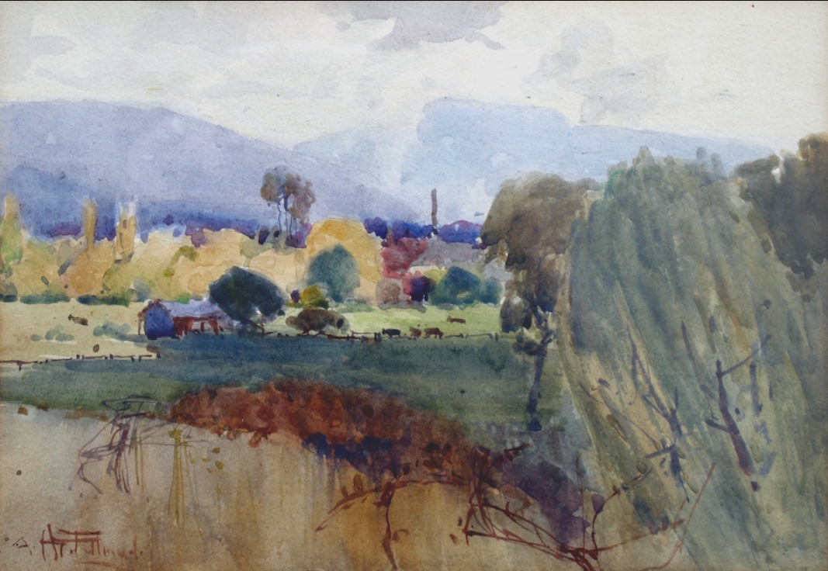
In March of 1897, Fullwood provided painting classes in the rural area of New Town, located on the dilapidated remains of Mezger's Mill, New Farm.
A Henry Fullwood, Study for the Rivulet at New Farm with Mezger’s Mill, 1897

Slide 48
Frederick McCubbin produced several views including Mezger’s Mill, near Hobart, Tasmania when visiting the colony in 1899.
Correspondence from McCubbin to Roberts suggests that it was Fullwood, in Hobart again at that time, who introduced him to the site.
Frederick McCubbin, Mezger's Mill, near Hobart, Tasmania, 1899

Slide 49
In 1900 Fullwood auctioned his work and took his family first to New York for a year, then to London where exhibited at the Royal Academy of Arts from 1906 and the Salon de la Société des Artistes Français, Paris.
Demobilized after serving in France in WWI as an official war artist , Fullwood returned to Sydney where he was a founder of the Australian Painter-Etchers' Society.
In 1924 he served on the first committee of the Australian Water-Colour Institute.
A Henry Fullwood, Paris in Autumn, 1902

Slide 50
A Henry Fullwood, The Lovers' Walk

Slide 51
Louisa Jane Swan (1860–955), studied art at the Hobart Technical College but was largely a self-taught plein air landscape painter. She also had lessons with Fullwood in 1897. Swan was important in the development and promotion of art in Tasmania – particularly through art societies.
Louisa Swan, Old Mill New Town, c 1897

Slide 52
Curzona Frances Louise (Lily) Allport (1860 – 1949)
Tasmanian born painter and printmaker Allport studied with Herbert Voss in the late 188os in London, then in Paris and Rome, and in a relatively short time was successfully exhibiting, selling, teaching and publishing her art.
Lily Alport, Parisian Art Scene

Slide 53
On 12 February 1894, the Mercury stated that Miss Allport had become 'the first Tasmanian to gain the distinction of having works hung in the Royal Academy' - her work was hung there in 1893, 1894 and 1906.
Allport also exhibited at the British Academy of Fine Arts in Rome. In London, she showed oil and watercolour paintings, lithographs, colour linocuts and woodcuts at the Goupil Gallery, the London Salon, the Royal Society of Portrait Painters and the Ridley Art Club.
Lily Allport, Melon Cellars in a Street of Stamboul

Slide 54
Lily Allport, Rocks at Bicheno, East Coast

Slide 55
Mastering the techniques of painting on silk, she created a series of fan-designs; in 1914 Spring song was included in an exhibition by Charles Conder and Aubrey Beardsley, 'Modern fan painters' in London.

Slide 57
Allport returned to Tasmania for five years between 1922 and 1927, producing fine watercolour landscapes.
She settled in Hobart at the age of 72 and set up a print studio.
Lilly Allport, St David's Park, Hobart, 1923

Slide 58
A few other ex-pats painting in Europe around 1900
Tudor St George Tucker
Emanual Phillips Fox
Ethel Carrick
George Lambert
Dora Meeson
Tom Roberts

Slide 59
Tudor St George Tucker
Painted in 1903, soon after Tudor St George Tucker returned to Europe in 1899, Tucker used white paint freely, while employing a brushy gestural technique to define the textures of different forms.
He captured the effects of light and shade on a homely, domestic scene.
Tudor St George Tucker, Nasturtiums, c1903

Slide 60
By 1899 he had settled at Chelsea, but continued to exhibit widely at the Royal Academy, Birmingham and Liverpool.
Tudor St George Tucker, Our Tent at Swanage, Dorsetshire, c.1903

Slide 61
E. Phillips Fox
Phillips Fox returned to Europe in 1901.
After a visit to
Paris he stayed at St Ives and later London.
He exhibited at the Royal Academy from 1903.
E Phillips Fox, The Grand Canal, Venice, c1906

Slide 62
E. Phillips Fox delighted in capturing the differences in the tone of colours under light and shade.
Here the full blaze of a summer's day is gently filtered by the green parasol bathing the woman's face, hands and her pale green organdie dress in soft light.
He applied the paint heavily, juxtaposing touches of pure colour, to produce an effect of shimmering light.
He also left some areas of the canvas unpainted-to create light and air.
The model for the painting was Edith Anderson, Penleigh Boyd's fiancé and the setting was the Foxs' Paris garden.
E Phillips Fox, The Green Parasol, c1912

Slide 63
Notes:
E Phillips Fox, the Green Parasol

Slide 64
In 1906 he began exhibiting at the New Salon and elsewhere in Paris.
He became a member of the International Society of Sculptors, Painters and Gravers, an associate of the Société Nationale des Beaux-Arts in 1907 and its sociétaire in 1910.
He and his wife, Ethel Carrick, travelled between Australia and Europe until his death in 1915.
Emanuel Phillips Fox, In the South of France, c1911

Slide 65
Ethel Carrick
Carrick first showed her work in London in 1903 and later exhibited widely in Britain, France and Australia.
She was one of a group of Australian women artists who sought to establish themselves in Paris and London through joint exhibitions in Europe in the 1920s.
Ethel Carrick, On The Beach, c1909

Slide 66
Ethel Carrick
By 1908 Carrick Fox was a member of the Union Internationale des Beaux-Arts et des Lettres.
In 1911 she became sociétaire of the Salon d'Automne, later an associate of the Société Nationale des Beaux-Arts and prior to 1913 was the vice-president of the International Union of Women Painters.
In 1928 she won the diploma of honour at the International Exhibition of Bordeaux.
Carrick-Fox flourished in Paris with her passion for the Jardin du Luxembourg and the open-air markets. She found inspiration in their bright colors, lively human scenes and richly dappled light.
Ethel Carrick, Paris Park, 1906
Ethel Carrick, Paris Park, 1906

Slide 67
Ethel Carrick, Watching the Fleet from Domain, 1913

Slide 68
George Lambert (1873-1930)
Lambert attended night classes conducted by Julian Ashton for the Art Society of New South Wales in 1889-91.
His painting, 'Across the Black Soil Plains', which expressed a nationalist sentiment through the honest labour of horses, won the 1899 Wynne prize and was bought by the National Art Gallery of New South Wales for 100 guineas
George Lambert, Across the black soil plains, 1899

Slide 69
In 1901 he moved to Paris, from London, where he studied at Colarossi's art school and at the Atelier Delécluze.
In Paris he particularly admired seventeenth-century artists such as 'Rubens the rollicking and Vandyke the irreproachable', Velasquez, and such of his contemporaries as J. M. Whistler and John Singer Sargent whom he felt had preserved the qualities of old masters.
George Lambert, La Guitariste, 1902

Slide 70
He returned to London in 1904 and before World War I Lambert's principal work was in portraiture, both paintings and drawings.
The paintings, often large uncommissioned studies of his family and friends, are invariably characterized by a sober palette, generalized landscape background, and a self-conscious treatment of hands, but a fine evoking of the tone of flesh and texture of costume.
Several of these portraits were hung in exhibitions of the Royal Academy of Arts — the first, in 1904, was a half-length of Thea Proctor.
George Lambert, Thea Proctor, 1905

Slide 71
In December 1917 he was appointed an official war artist, A.I.F., with the honorary rank of lieutenant, and commissioned to execute twenty-five sketches and to paint 'The Charge of the Light Horse at Beersheba' on 31 October 1917.
In January 1919, as honorary captain, he visited Gallipoli on the historical mission with Charles Bean, who noted that Lambert 'was, I think, more sensitive than the rest of us to the tragedy — or at any rate the horror — of Anzac'.
George Lambert, A Sergeant of the Light Horse, 1920

Slide 72
Dora Meeson (1869–1955)
Meeson studied art at the National Gallery School, Melbourne, the Academie Julian in Paris under Benjamin Constant and Laurens and Slade School of Art, London.
She established herself (with artist husband George James Coates) in Chelsea in 1903 where they became members of an extensive circle of Australian expatriate artists, including
Tom Roberts and
George Lambert.
Dora Meeson, Thames at Chelsea Reach, c1913

Slide 73
In 1921, Meeson returned to Australia, where she held multiple exhibitions in Melbourne and other cities.
She discovered that her English scenes of the Thames sold very well in Australia, while her Australian scenes sold equally well back in England, and obligingly completed a whole series of Australian landscapes while touring Victoria, before the couple returned to England.
Dora Meeson, Thames, London

Slide 74
Dora Meeson, Woman in Profile, 1917
Dora Meeson, In a Chelsea Garden, 1912

Slide 75
Her work is in UK collections including the Imperial War Museum, the Museum of London Docklands, and the National Army Museum, and extensively represented in Australian collections including in the Art Gallery of New South Wales, Sydney.
Dora Meeson, Members of the Queen Mary's Army Auxiliary Corps, At Work in the Cookhouse, Royal Air Force Camp, Charlton Park, 1919

Slide 76
Tom Roberts returned to London in 1903 to complete the 'Big Picture' (1570 sq. feet, 518 cm x 305 cm). He had 'longed and longed' to return to England, but he did not receive the patronage he expected despite his contacts with Royalty while painting the picture, and, uncertain of the direction his art should follow, he entered a 'black period' for several years.
Although Roberts had considered the commission to be the peak of his career, the need to represent accurately so many figures and the importance he placed on the task sapped his energy and weakened his eyesight.
Tom Roberts, A Towpath, Putney, 1904

Slide 77
Tom Roberts, Thames Barges, c 1909 - 1912
Tom Roberts, Putney Bridge, London, c 1905-08

Slide 78
Portraits were again his bread and butter; one was 'hung on the line' at the Royal Academy in 1910, but he barely made ends meet during sixteen years in London.
Tom Roberts, Grey lady (Mrs Ince), c1910-12

Slide 79
Tom Roberts, Winter, England, c1920
Tom Roberts, Copse in Winter, c 1910
Hampstead Heath paintings

Slide 80
In 1913 Roberts held an exhibition of alpine landscapes, but his confidence had been lacking and his hopes disappointed. He had organized an Australian artist group based on the Chelsea Arts Club and was often nostalgic for the 'Sunny South'.
Tom Roberts, The First Basin, Lake Como, 1913

Slide 81
He returned to Australia in December 1919, stayed for a year and held exhibitions in Melbourne and Sydney whose success encouraged him to return finally early in 1923. Roberts died in 1931.
Tom Roberts, Dandenong Landscape, 1925
Tom Roberts, An island on the Tweed, c 1920

Slide 82
Tom Roberts, The First of Spring, 1922

Slide 83
Arthur Streeton, Golden Summer, Eaglemount, 1890

Slide 84
Plein Air Painting
&
Australian Impressionism
Andrea Hope
www.australianarthistory.com

