Slide 1
Emma Minnie Boyd
Art and Opportunity in Marvellous Melbourne
Andrea Hope
www.australianarthistory.com

Slide 2
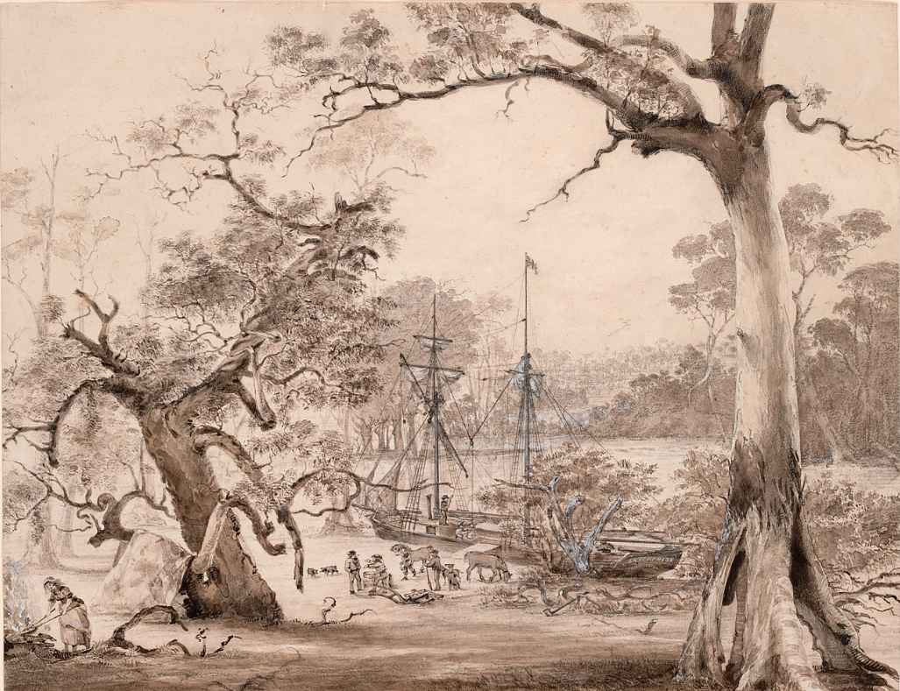
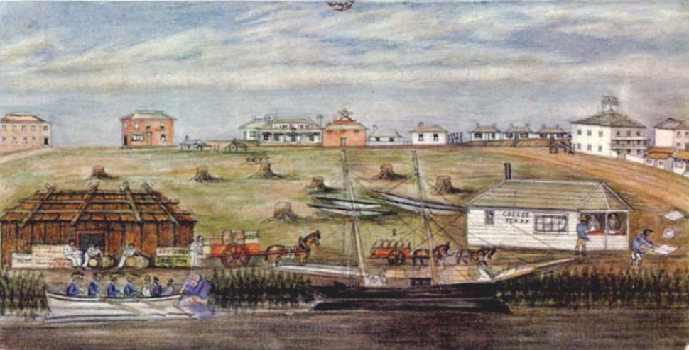
Melbourne was founded on the Yarra River in 1835
“Melbourne in 1840 was certainly not a city and could hardly be called a town; nor did it even partake of the character of a village or a hamlet. It was a kind of big settlement in groups pitched here and there, with houses, sheds and tents in clusters, or scattered in ones and twos – During winter the streets were chains of waterholes, and the traffic had to be suspended in places – Elizabeth Street and Swanston Street were shallow gullies, with deep and dangerous ruts every twenty yards; Flinders Street was a swamp”
Gained independence from New South Wales in 1850 – gold rush commenced shortly afterwards
It has been said that by 1860 the city had reached its final form, most of the land had been sold and many of the sections of the town had attracted special types of occupancies which still characterise the city today. The eastern end of Collins Street had attracted members of the medical profession while the central and western section of this same street saw insurance companies, banks and building societies established. Bourke Street had its theatres and much halls, while the western section of Little Collins Street had attracted the legal profession
Landing at Melbourne, 1840

Slide 4
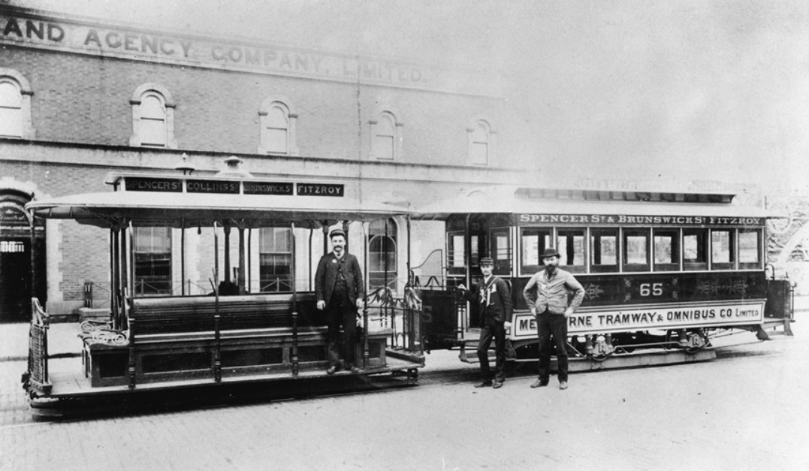
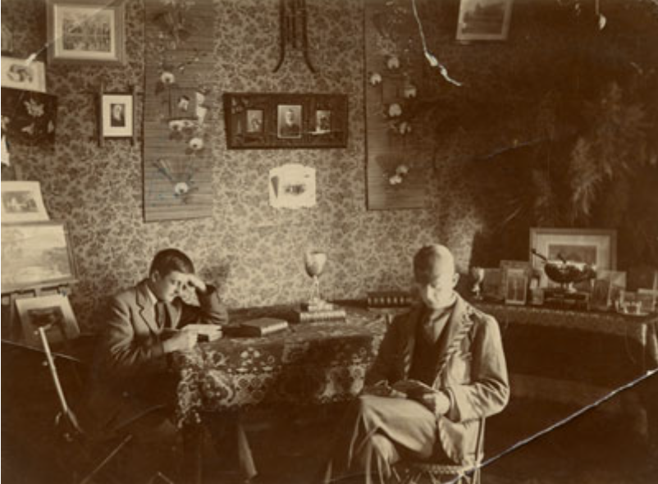
Until the 'crash' in the 1890s, Melbourne was thriving
The population of Victoria at this time was just under one million, with about half that number living in Melbourne.
The first railways were built in the 1850s and by the 1860s it was possible to travel from Melbourne to Richmond, Brighton, Hawthorn, Bendigo and Ballarat.
The first cable tram was operating along Flinders Street to Richmond by 1885. Within five years, trams were ferrying people between the city and inner suburbs along 65 kilometres of tram tracks.
Melbourne had the first telephone exchange in Australia and by 1887 there were approximately 8000 calls a day.
Melbourne University, which was established in 1853, began to admit women in 1880 (except in study of Medicine)

Slide 5
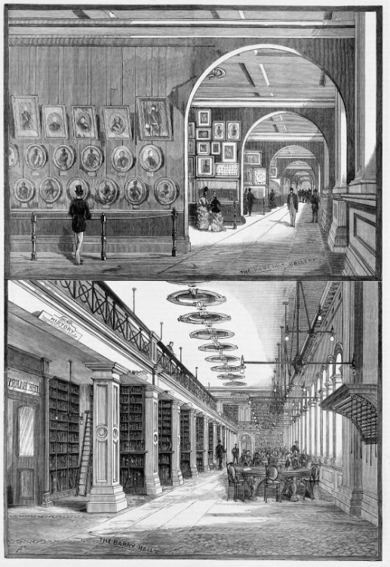
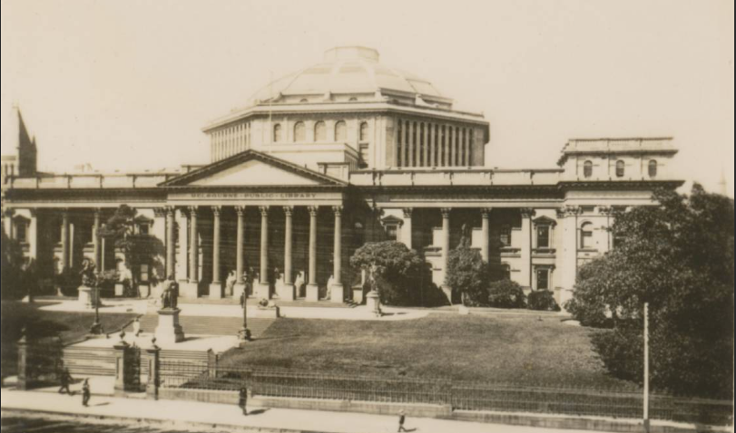
The Public Library, now known as the State Library of Victoria, opened in Melbourne in 1859
the National Gallery of Victoria opened in the 1860s, with the Government granting it the princely sum of £2000 to purchase art work. It was housed within the Library from 1875 and was the first gallery purpose built for paintings. The Gallery was immediately popular with early attendance figures of over 360,000 in its first year.

Slide 6
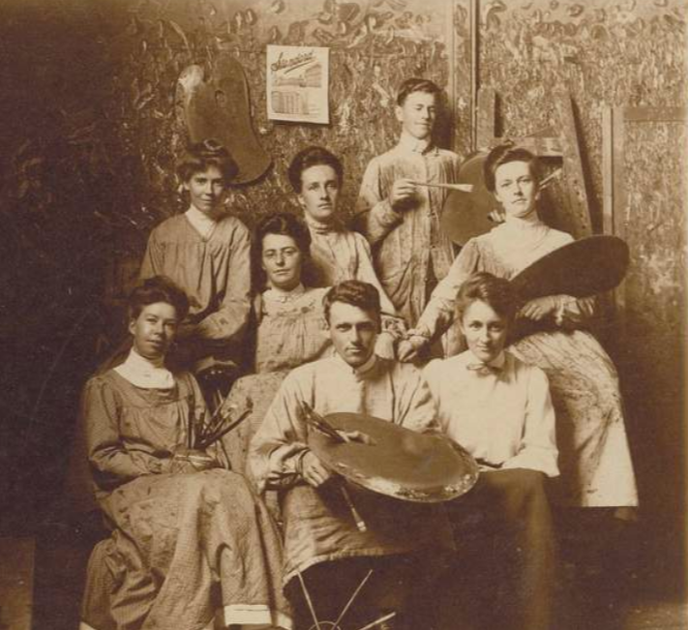
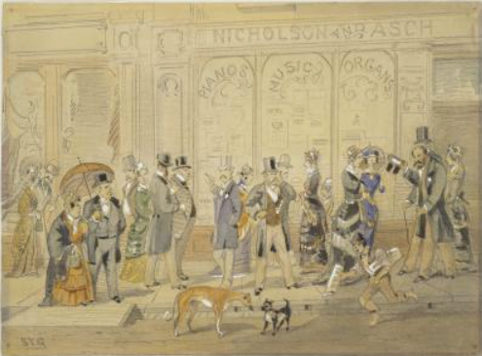
The National Gallery Art School accepted its first students in 1867.
The Carlton School of Design also opened in 1871
Private galleries and studios also began to appear. In upper Collins Street, from the GPO to Spring Street, there were art dealers, a framing store and a gallery.
In 1888 the purpose-built artists' studio complex, Grosvenor Chambers, which was the first in Australia, opened near the corner of Spring Street.
Tom Roberts created the most elaborate studio here in the aesthetic style, drawing on Asian influences and decor and light wicker work.
Melbourne's earliest known art society, the Victoria Fine Arts Society, commenced in 1856 and by 1888 the Victorian Artists' Society (VAS) was founded.
S T Gill, Doing the Block (Collins St), 1880

Slide 7
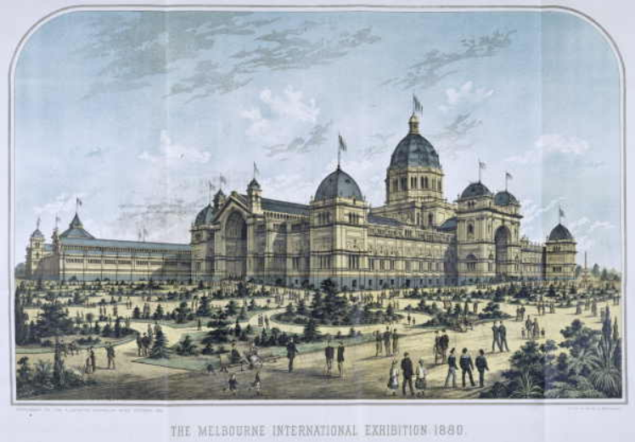
The Great International Exhibition of 1880-1 was held at the Royal Exhibition Building in the Carlton Gardens. The exhibition included everything from works of art, furniture and accessories, and textiles to raw and manufactured products, agriculture and horticulture.
Writer, Henry Gyles Turner said, “From that day forward, much of the narrow provincialism of the colonists vanished. The new chum, once the derided butt of the old identities, was no longer rudely stared at, and Collins Street began to take on a cosmopolitan aspect.”

Slide 8
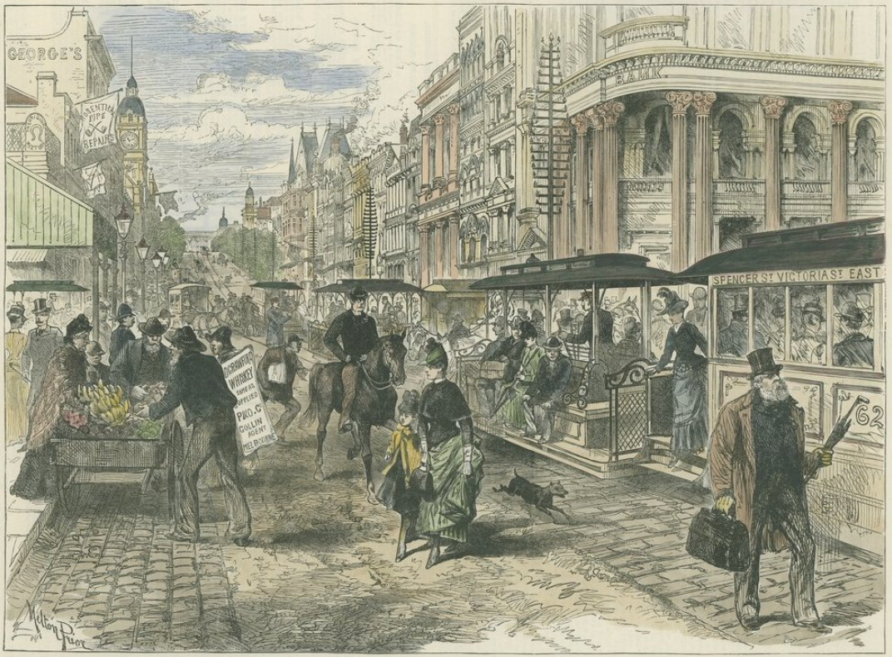
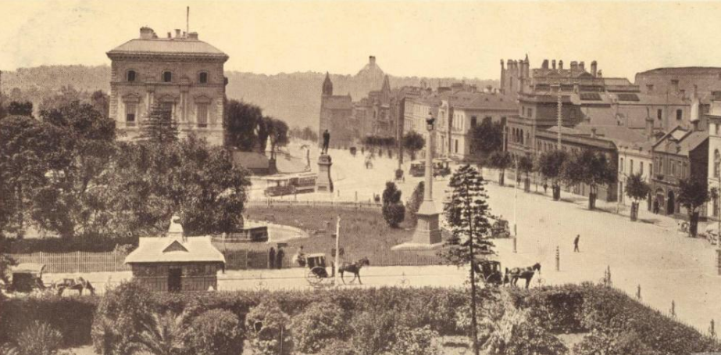
Sir Archibald Michie QC, who was Victoria's Attorney General in the early 1870s, remembered the Melbourne of 1852 as little more than 'a very inferior English town’.
Only eight years later, he was astounded by Melbourne's transformation into 'a great city, as comfortable, as elegant, as luxurious as any place’.
The gold rush saw Melbourne transform from a muddy frontier town to a solid city of spires and domes.

Slide 9
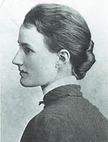
Emma Minnie Boyd
(1858 - 1936)
Painter in oils and watercolours, a printmaker, sculptor, children's book illustrator, ceramics painter Also made numerous sketches.

Slide 10
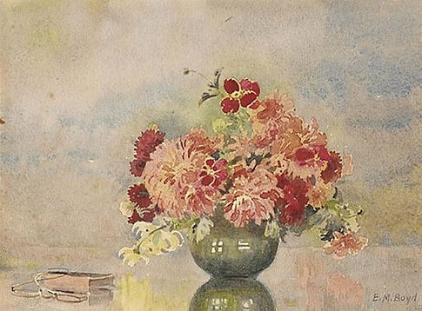
Emma Minnie Boyd, Flowerpiece

Slide 11
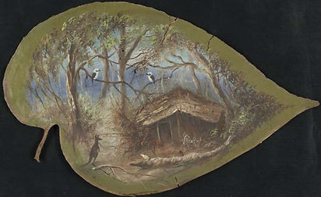
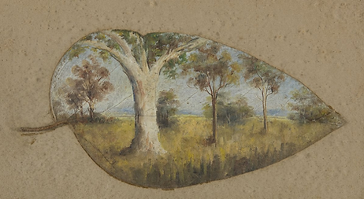
Emma Minnie Boyd, Bush Scene, The Walk Chiltern area of North Eastern Victoria, 1860s
Emma Minnie Boyd, A Summers Day, Gum Trees in a Paddock, date unknown, Bundanon Trust

Slide 12
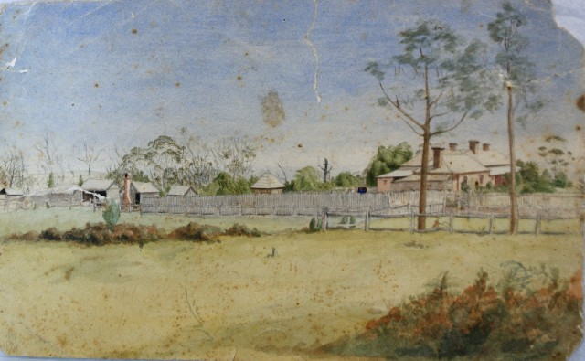
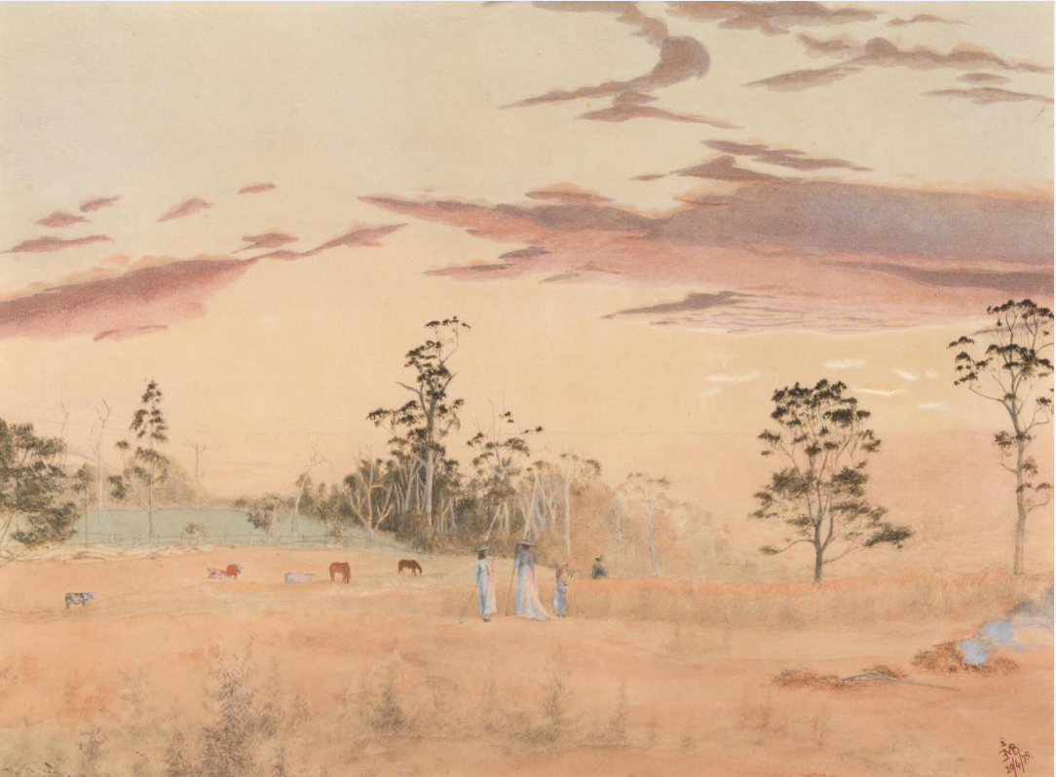
Grandfather Sir William à Beckett first chief Justice of Victoria
At age 22 he had eloped with 18yr old Emma Mills – her father John Mills was a convict transported to Tasmania in 1826
John Mills later made a fortune from brewing and property interests – provided for Emma in his will which left the next generation of à Becketts quite wealthy
Purchased The Grange in hills at Harkaway near Melbourne with magnificent views
Minnie one of 6 children who had a very comfortable lifestyle
Minnie’s talent supported by her parents and relatives
Emma Minnie Boyd, The Grange, 1874; View from the Grange, 1875

Slide 13
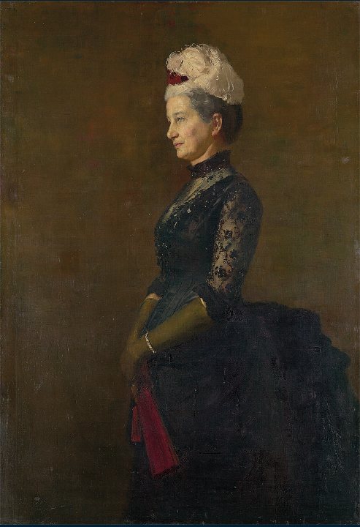
Reports that she attended two different schools
Madame Pfund’s School & Madame Vieusseux's School
Swiss-born Madame Elise Pfund established Oberwyl in 1867
highly regarded private girls’ school in St Kilda
classes were offered in arithmetic, reading, writing, spelling, elocution, history, geography, mapping, scripture, nature study, music, singing, drama, dancing, drawing, needlework, physical culture and tennis
charitable work was an important part of the curriculum
Elise Pfund was one of the important patrons of Heidleberg artists such Tom Roberts, who painted portraits of both Elise and her husband.
Tom Roberts, Madame Pfund, c1887

Slide 14
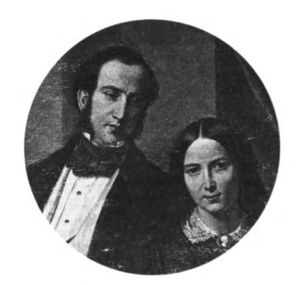
Brenda Niall wrote that Minnie had lessons at Madam Julie Vieusseux's school, where the 'elegant, cultured and cosmopolitan' principal set high standards in the teaching of art and French
Vieusseux arrived in Australia in 1852 with her husband Lewis and sons. They were among the thousands who migrated to Melbourne during the gold rush period.
She had been educated in Paris and was earning a living in their first precarious months in Melbourne. Within a year she advertised “Drawing and Painting Classes for Young Ladies, who can enjoy the advantage of French conversation”
In 1857, founded the Vieusseux Ladies’ College which quickly became a highly fashionable establishment
The school had high academic standards with lessons in language and literature classes, English, French and German. Vieusseux also taught drawing, painting and craft classes.
Julie and Lewis Vieusseux

Slide 15
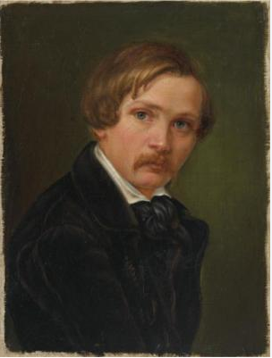
Vieusseux exhibited at the third Victorian Industrial Society exhibition in December 1852 where she received the highest possible awards.
In April 1853 advertised an exhibition of her paintings at the Melbourne Mechanics Institute, informing the public that her "much admired collection of Oil Paintings' could be viewed there daily before their dispersal through an art union to be drawn on 7 May“.
Two of her chalk drawings of female heads were also shown at the 1866 Melbourne Inter-colonial Exhibition.
(Unfortunately few of her paintings are still in existence, so it is difficult to see her direct artistic influence on the Minnie.)
Julie Vieusseux, Portrait of Eugène von Guérard

Slide 16
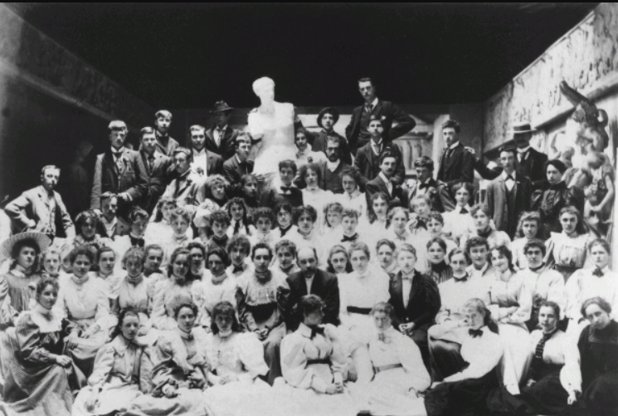
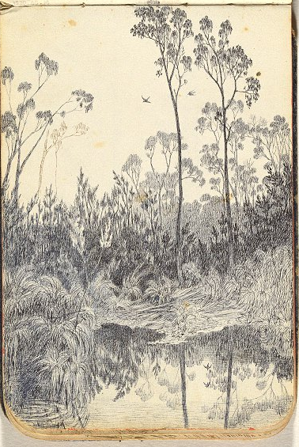
National Gallery School
In 1876, 1877, 1879 and 1882 Minnie attended the National Gallery School, which had only opened in 1867
The Gallery School remained perhaps Australia's most prestigious art education school, until its importance waned with the acceptance of Modernism in the 1930s
Tuition at the school varied over the years, according to the interests of different teachers. Generally, however, classes followed the model of the European art academies.
Students commenced their studies in the School of Design where they learnt the fundamentals of drawing, including outline drawing and tonal modelling of form.
In the process they progressed from drawing plaster casts of antique sculptures to drawing from the human figure.
Students at the National Gallery of Victoria Art School, 1895
Emma Minnie Boyd Bushland with Pond, drawing, c1876

Slide 17
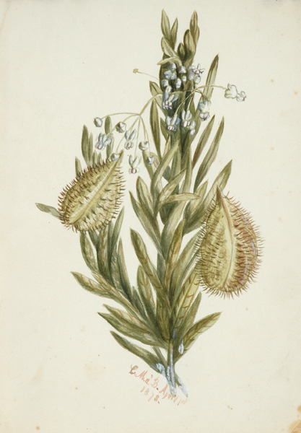
Students would then progress to the School of Painting which taught traditional painting skills.
These included compositional skills and the academic technique of building up a painting in many layers, starting with thin paint and dark tones, and finishing with thicker paint and lighter tones on the surface.
Artists who were studying there during that period included Emanuel Phillips Fox, Rupert Bunny, Frederick McCubbin, Tom Roberts, May Vale, Jane Sutherland, Clara Southern, Josephine Muntz Adams and Arthur Merric Boyd, who was to become Minnie's husband in 1886.
Emma Minnie Boyd, Flower Study, 1878

Slide 18
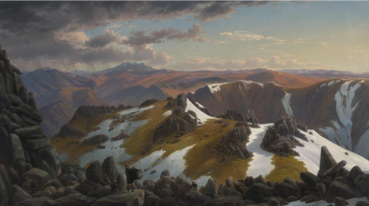
Minnie was tutored by Eugene von Guerard, Oswald Rose Campbell and George Folingsby at the National Gallery School
Eugene von Gerard, who embodied the Romantic approach to painting in his large canvases such as North-east view from the northern top of Mount Kosciusko, was appointed the first Master of the School of Painting but was criticised for his outmoded teaching techniques.
He expected his students to copy works from the gallery, rather than painting original works.
Eugene von Gerard, North-east view from the northern top of Mount Kosciusko, 1863

Slide 19
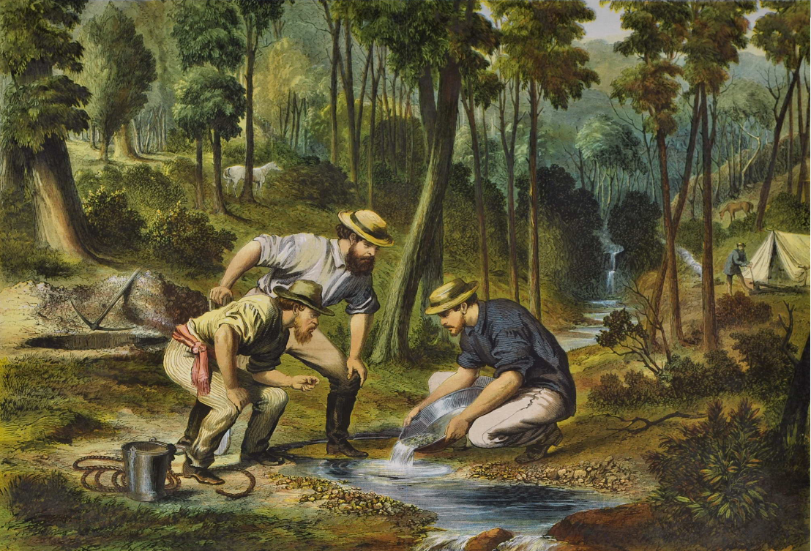
Oswald Rose Campbell, who had trained at the Royal Academy School in London, was appointed as drawing-master in 1876, and over the next nine years he appears to have been rather inflexible and dictatorial, following strict academic lines.
In 1879-80 he was the central figure in a controversy over a life-class. Campbell wrote to the trustees defending his teaching and asserting that his pupils were not yet ready for anything beyond drawing, anatomy, perspective and modelling, and that they abused the freedom granted to them.
He was supported by the majority of his pupils, and their letters in praise of his teaching methods seem to have reinstated him with the trustees, but the rebels won the right to have a life-class at which Campbell was expected to teach.
Oswald Rose Campbell, Prospecting In Australia, 1870

Slide 20
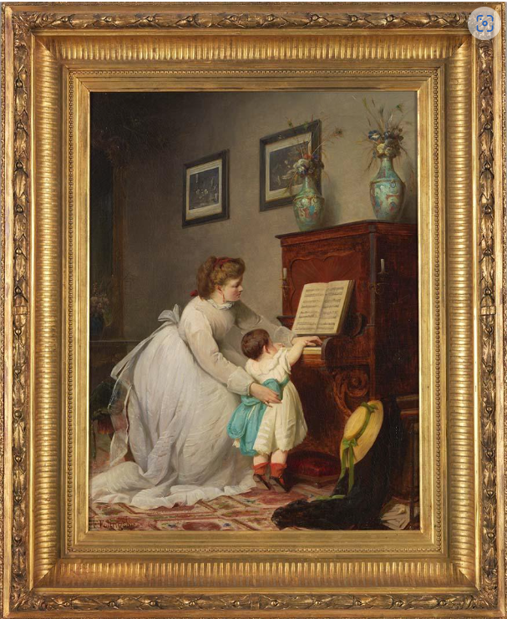
In 1882 George Folingsby revised the teaching methods at the School by teaching painting directly from life, with studies in antique sculptures and still life before progression to studies in composition
“He first took students away from copying in the Gallery to original work, and laid the foundation of what may become a school of art of which the subjects are purely Australian. From his own training and practice – which has been devoted almost exclusively to figure- painting – his pupils were naturally led the same way, but landscape was not neglected.
However, Folingsby believed that oil sketches painted outdoors should be considered only as preparatory sketches for completion in the studio as more highly finished works.
George Folingsby, The first lesson 1869

Slide 21
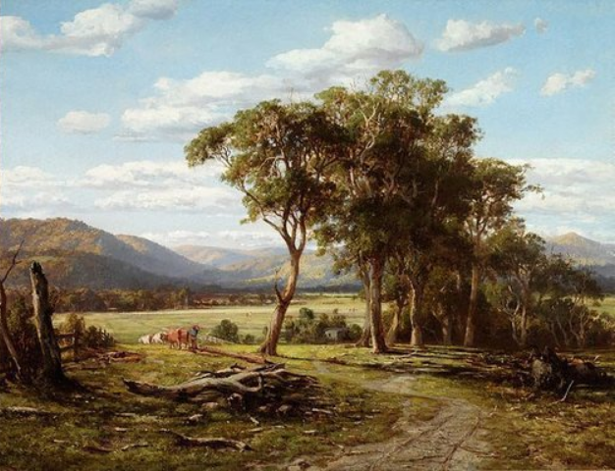
Louis Buvelot
Around late 1870s Minnie received tuition from Louis Buvelot
Buvelot was regarded as a leading landscape artist from late 1860s to late 1880s
important to the development of plein air (outdoor) painting in Australia as his background was the French Barbizon School
artists painted rural scenes and portrayed local peasants with powerful simplicity and dignity. They were painting what they saw rather than imagined, and their style became known as Realism
“Buvelot was not ambitious to paint large canvases depicting sublime mountain scenery or the great open spaces of the interior … he was attracted by homely, rural scenes usually painted in warm light of the late afternoon or early evening”
Louis Buvelot, At Lilydale, 1870

Slide 22
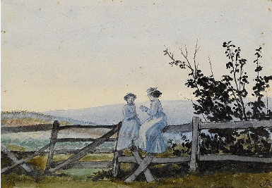
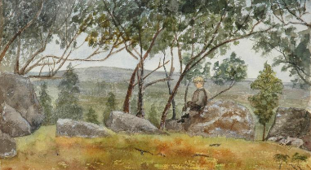
Emma Minnie Boyd (A'beckett) Mornington Peninsula, 1879
Emma Minnie Boyd, Resting on the Rock, 1879 watercolour

Slide 23
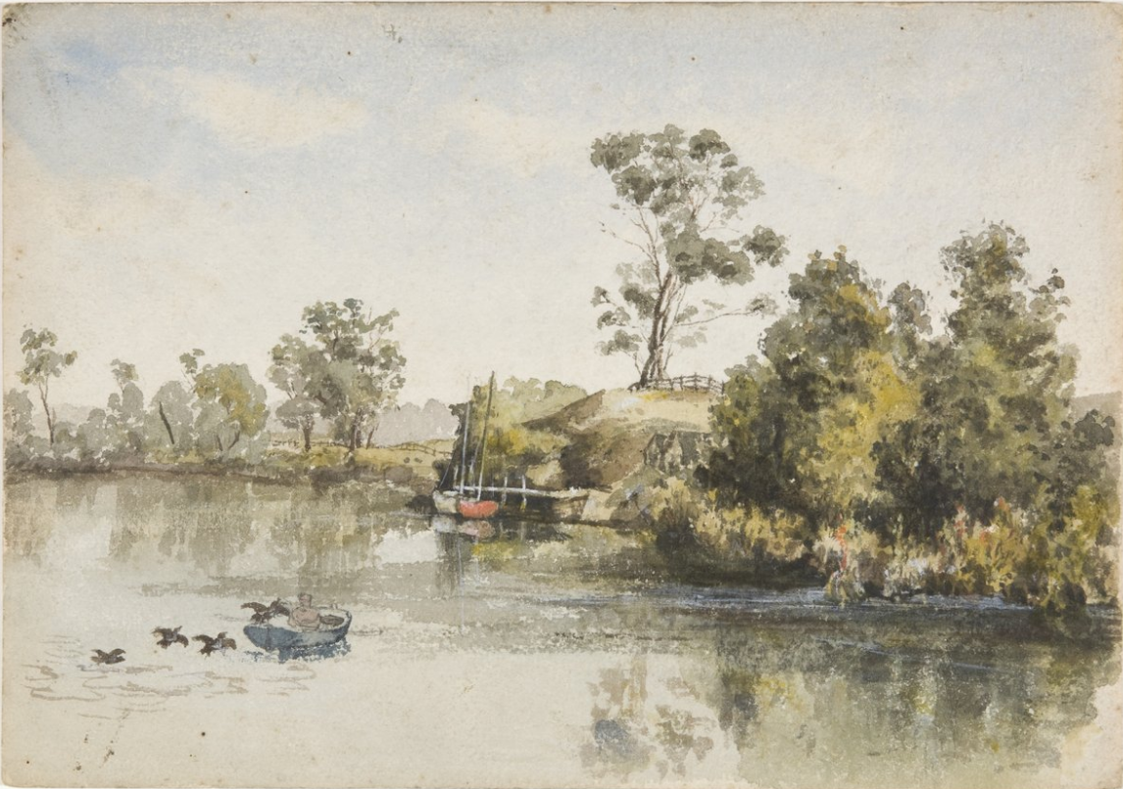
Emma Minnie Boyd, River with Fisherman and Birds, 1880, Bundanon Trust

Slide 24
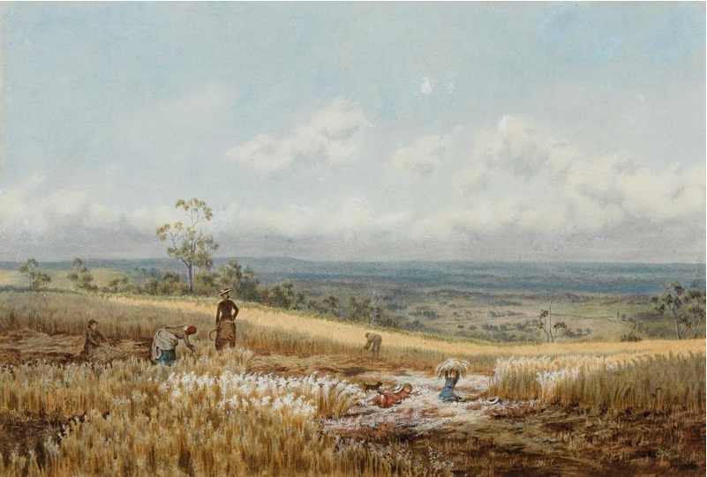
Emma Minnie Boyd, Harkaway Landscape 1879

Slide 25
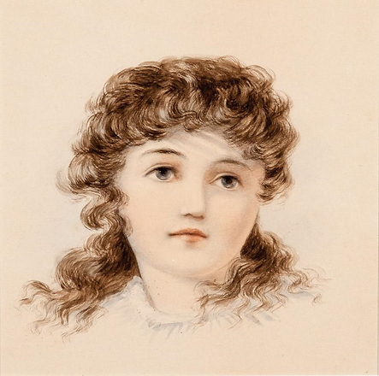
Emma Minnie Boyd, Young Girl, 1880

Slide 26
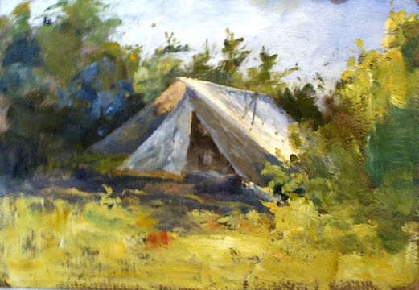
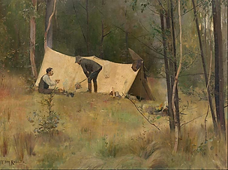
Tom Roberts, The Artists' Camp, 1887
Emma Minnie Boyd, A Bush Camp (c. 1870s)

Slide 27
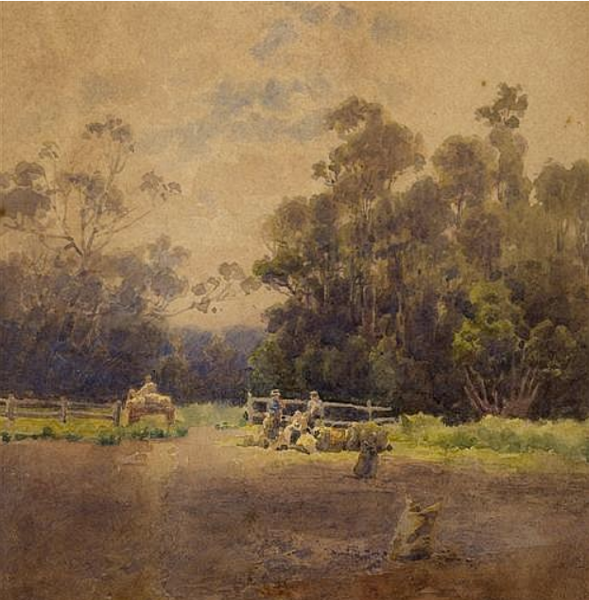
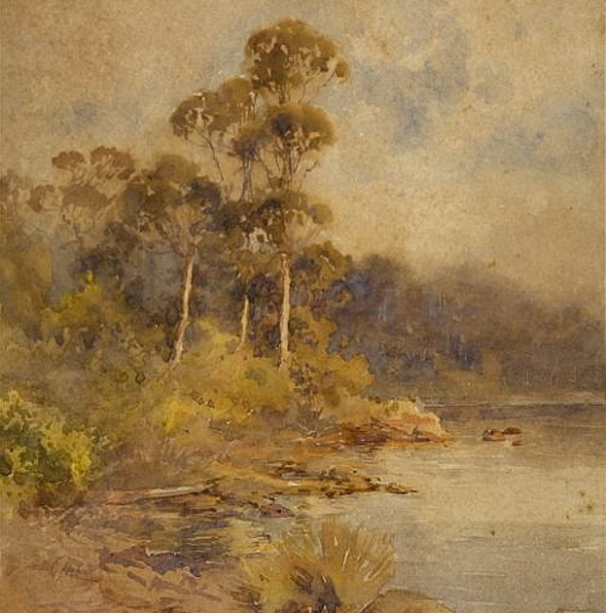
Emma Minnie Boyd, Riverbank, 1901
Emma Minnie Boyd, Rural Landscape, 1899

Slide 29
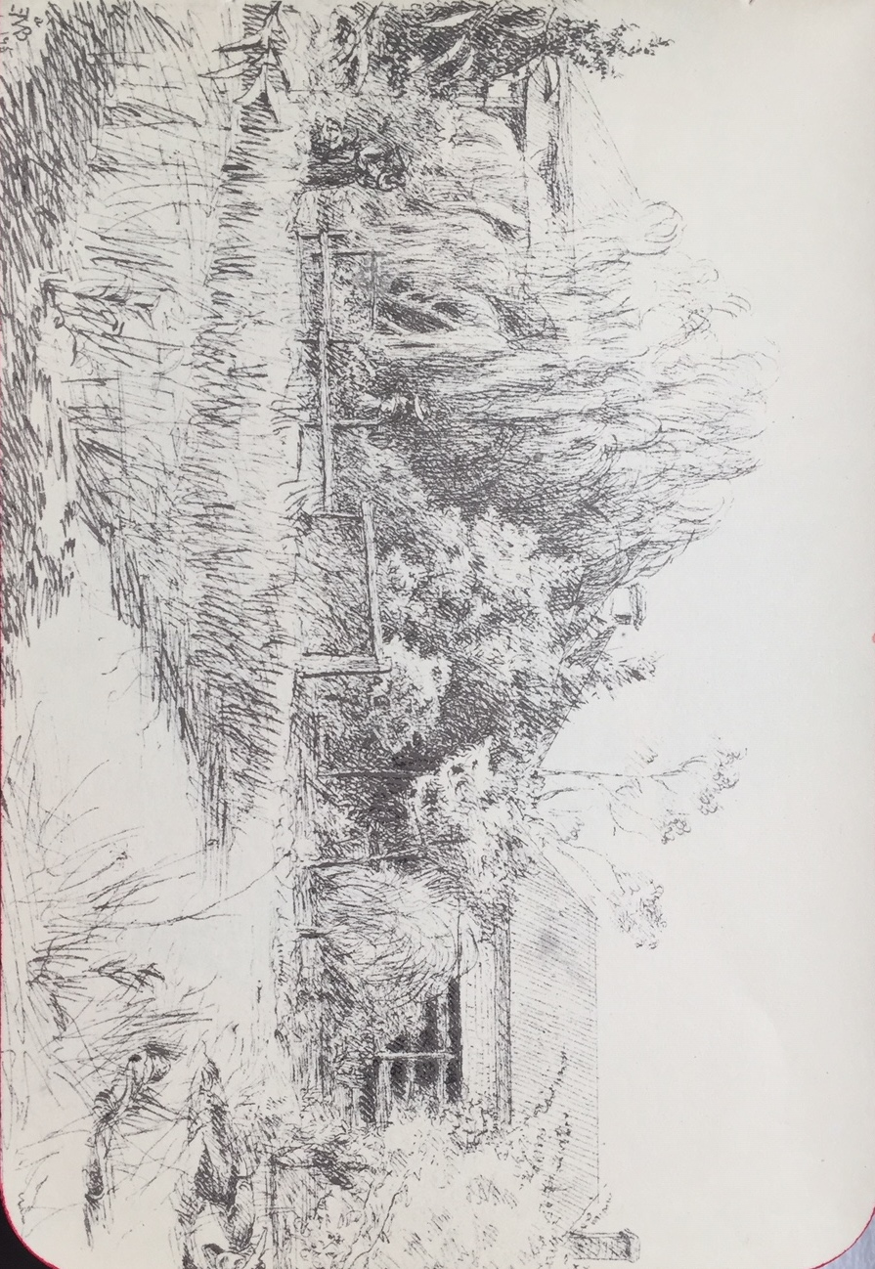
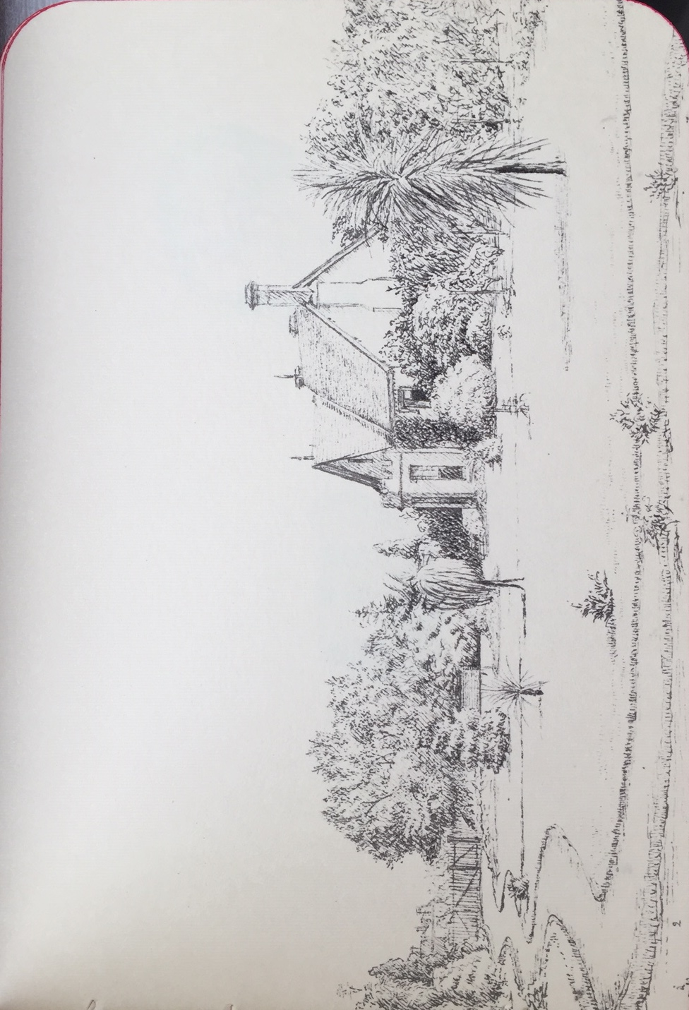
Sketchbooks 1874 - 1879

Slide 30
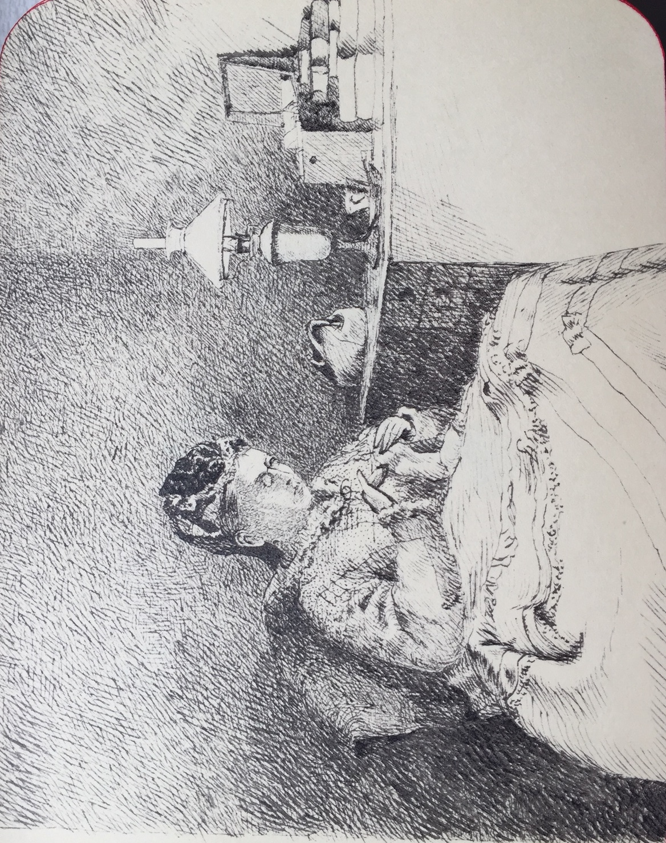
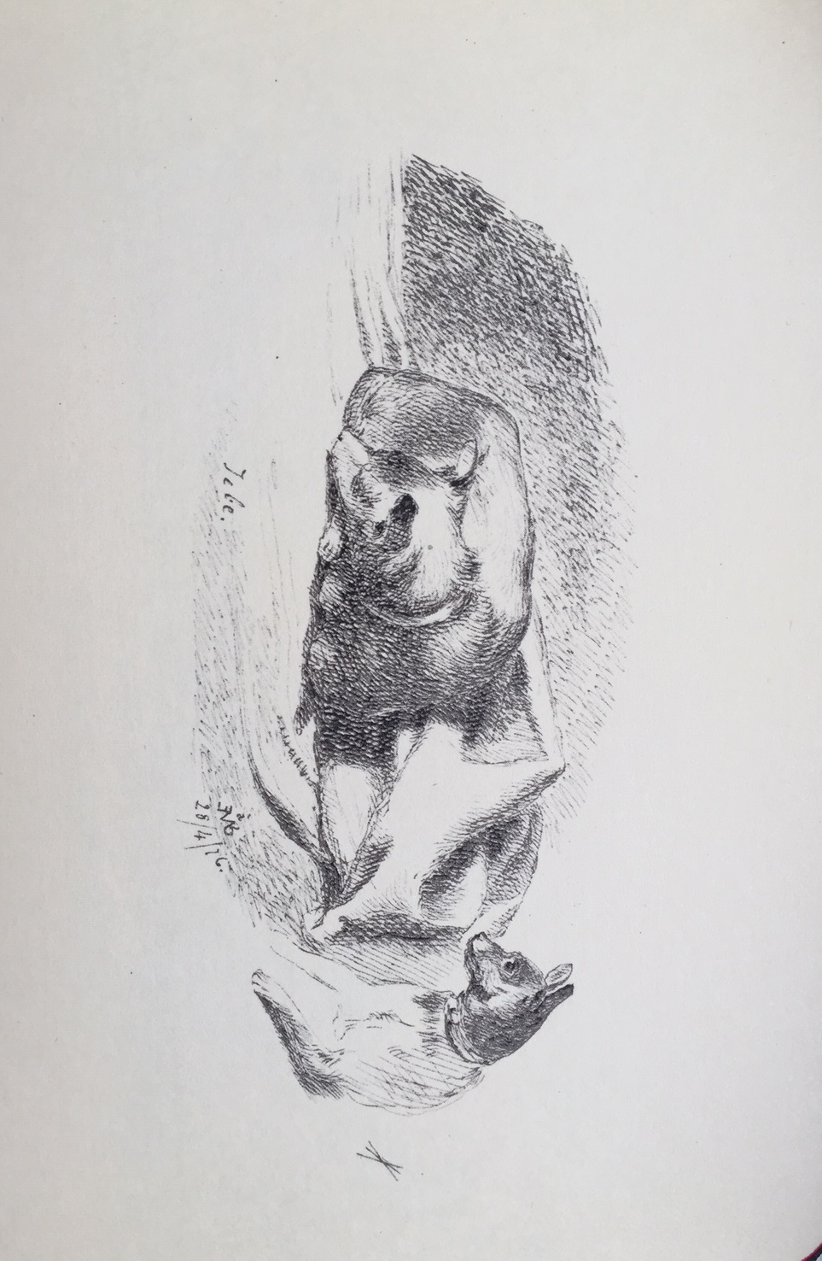

Slide 31
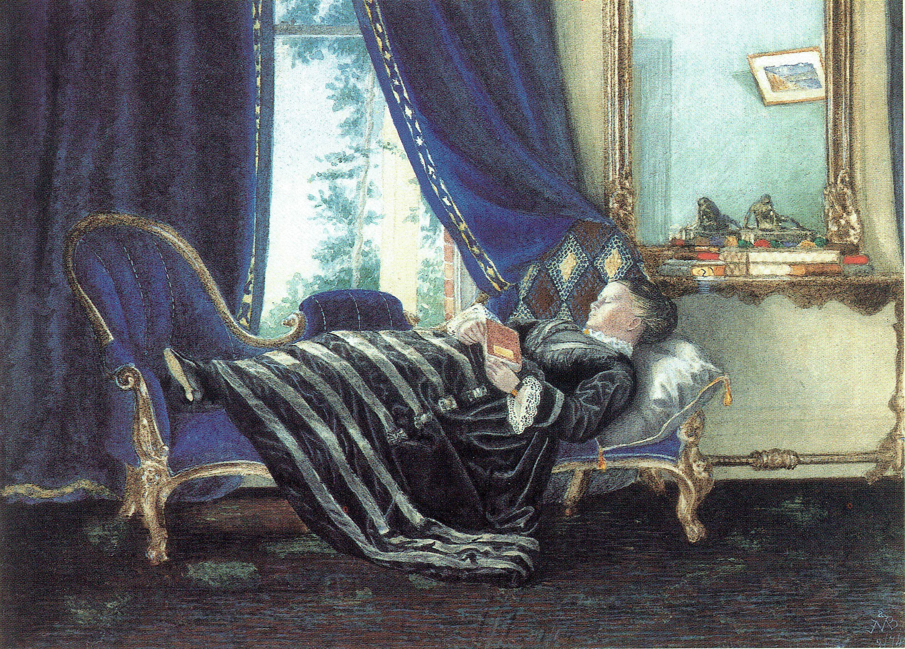
Exhibitions
First exhibited in 1874 (aged 15)
4th Victorian Academy of art exhibition
Painting of her mother asleep on chaise lounge at The Grange
Hung along works by artists such as Louis Buvelot and von Guerard
Ellis Rowan (flower painter) also exhibited at same time
Emma Minnie Boyd, An Afternoon Nap, 1874

Slide 32
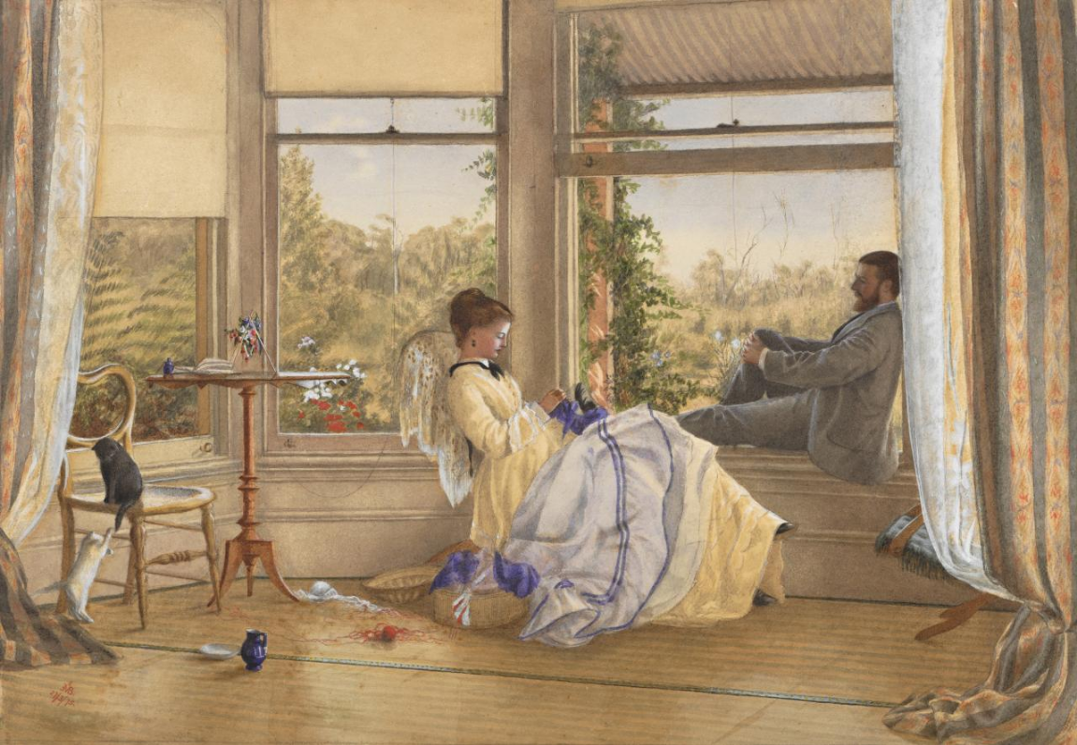
Victorian Academy of Arts (VAA)
Premier exhibiting body of the period
In 1875 Minnie showed 5 untraced watercolours,
2 figures and a sketch
No prices shown so probably not for sale
By 1878 exhibited 6 oils with prices ranging from £7/7 and watercolours from £6/6 – status changed from amateur to professional
In 1879 was amongst 10 other female exhibitors
Showed 4 paintings & Reaping (untraced) priced at £12/12/0 was amongst highest priced watercolours at exhibition
Was demonstrating her mastery of watercolour, and public acceptance
Emma Minnie Boyd, Interior with figures, The Grange, 1875

Slide 33
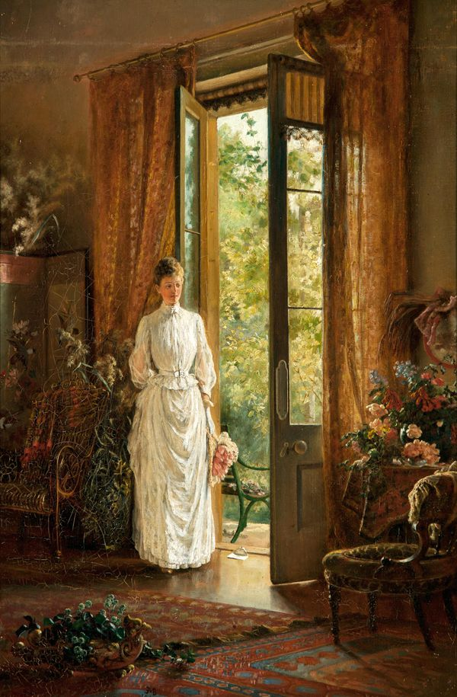
Other Exhibitions
Victorian Jubilee Exhibition in 1884
Colonial and Indian Exhibition in 1886
Australian Artists’ Association 1887 & 1888
Melbourne Centennial International Exhibition 1888-89
By 1889 the asking price for her oil painting, The Letter, at £32 was comparable with the prices being asked for by Frederick McCubbin and Arthur Streeton at the same exhibition, given the size of her work which was only 60 x 40 cm
Emma Minnie Boyd, The Letter, 1889

Slide 34
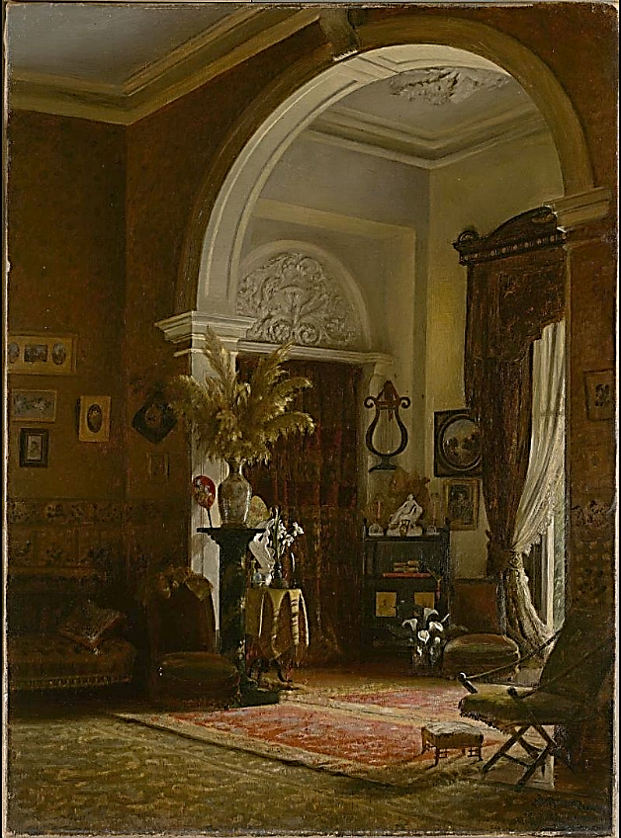
Buxton's Art Gallery
Minnie also exhibited at Buxton's Art Gallery the same gallery where the famous 9 x 5 Impressionist exhibition was held in 1887.
In his paper, Arabesques of Beauty: Cullis Hill, the 9 by 5 Impression Exhibition, decorative decor and painting Andrew Montana uses Minnie's painting, Corner of a Drawing-Room, 1887, to demonstrate the ambience artists were aiming for.
Interior genre scenes were typical of her work at the time . paintings of a leisurely lifestyle were often set against a backdrop of a window or door, inviting the viewer to become part of the scene. Even these early works demonstrate not only her painting and composition abilities, but also her understanding of light and shadow.
Emma Minnie Boyd, Corner of a Drawing Room, 1887

Slide 35
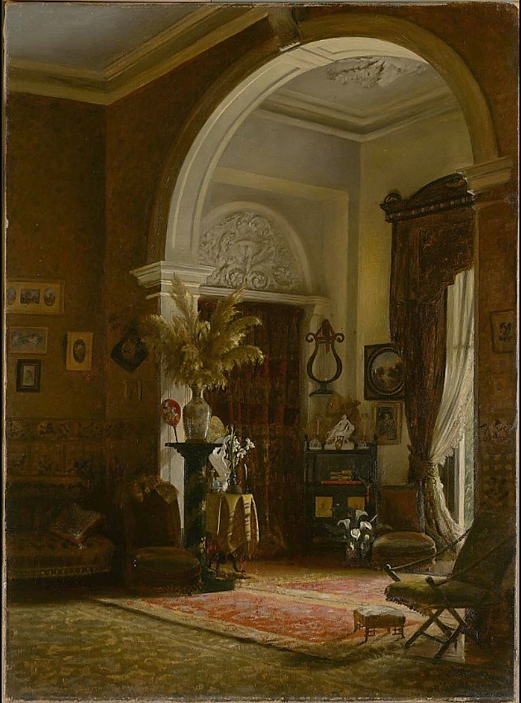

Slide 36
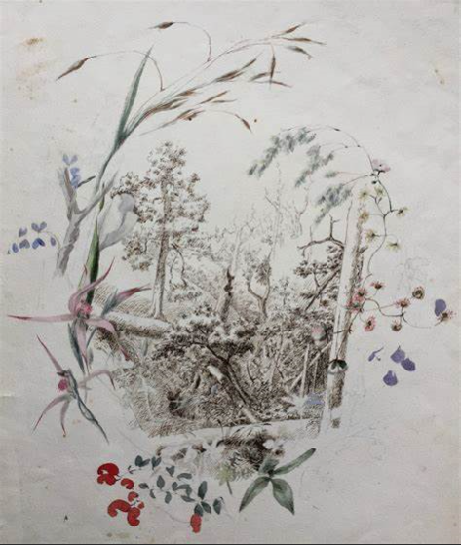
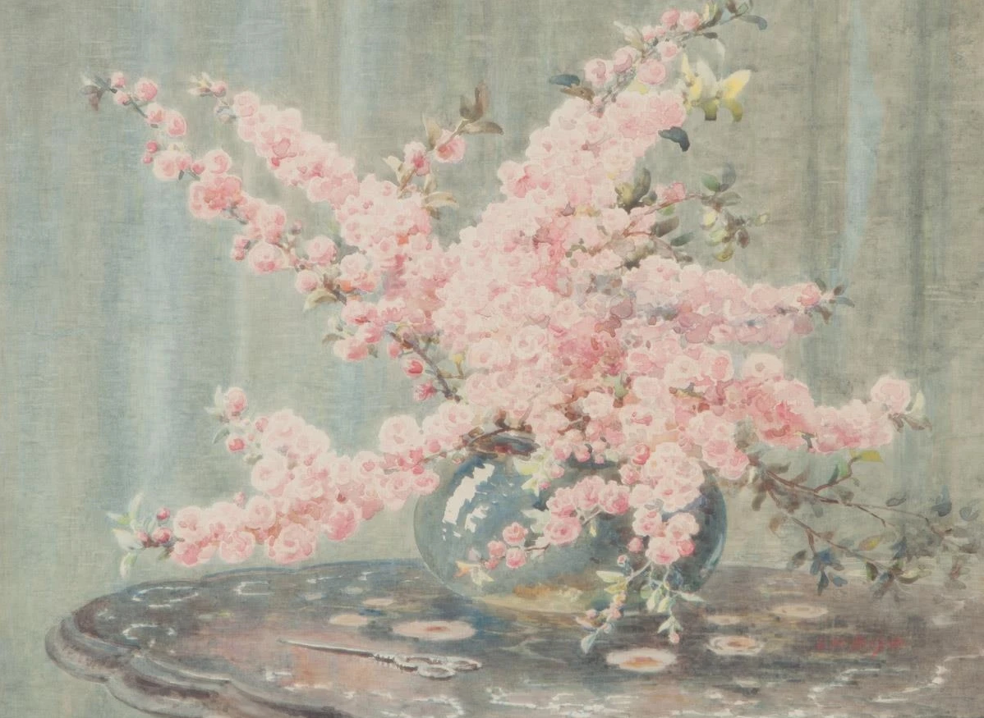
Botanic and Still Life Works
Emma Minnie Boyd, Sketch
Emma Minnie Boyd, Pink Blossoms

Slide 37
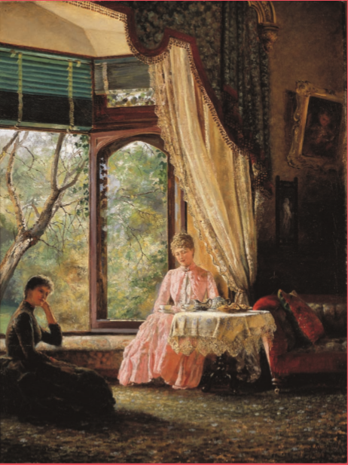
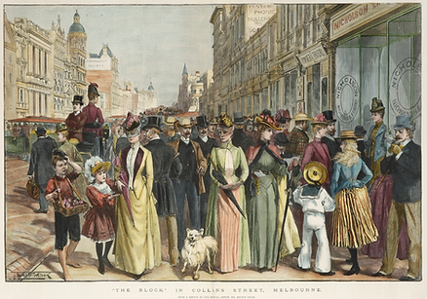
By the late 1880s she and husband Arthur Boyd were also working from a studio in Collins Street
Emma Minnie Boyd, Afternoon Tea, 1888

Slide 38
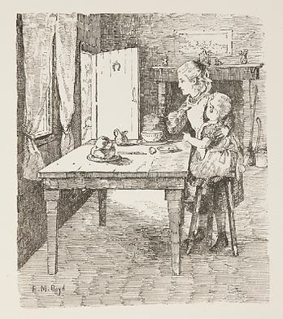
Children's Book Illustrations
Minnie was invited to prepare a number of illustrations for children's author and illustrator Louisa Anne Meredith's book, Waratah Rhymes

Slide 39
Europe
Travelled to Italy in 1890
Then to family Home of Penleigh House in Wiltshire
Submitted work to Royal Academy in London in 1891
Produced at least on etching
Learnt to paint small works in black and white
1892 paintings exhibited in Bristol
Studied for short time at Académie Colarossi, in Paris
Didn’t really become part of local art circle but did have some contact with other Australian artists including Streeton and Condor.
4th child born while overseas
Emma Minnie Boyd,
To the Workhouse, 1891

Slide 40
Emma Minnie Boyd, Hiker Leaving Hillside Village, etching, 1892
Emma Minnie Boyd, Girl with Parrot, c1891

Slide 41
Emma Minnie Boyd,
In Lucerne, 1893

Slide 42
Emma Minnie Boyd, The Two Esplanades from St Kilda Pier, c 1896

Slide 43
Return to Melbourne
Land crash of 1893 meant end of Marvellous Melbourne
Minnie’s parents income halved so less support for Minnie and Arthur
Minnie taught art to students in her city studio
continued to exhibit to the Victorian Artists Society
Emma Minnie Boyd, The Prayer, 1895

Slide 44
In 1902 Minnie and Arthur held a joint exhibition at the grand home of Como in Toorak, owned by their friends Caroline and Charles Armytage - where they were lauded as being 'amongst the best of Australian artists’.
They sold over £100 of paintings and were offered a number of commissions. At that time it was most unusual for artists to hold independent exhibitions, most artists exhibited more formally in groups.
Emma Minnie Boyd, Port Phillip Bay

Slide 45
Country Life
Moved to country after mother died in 1906
One son died age of 10 in 1896 and second in 1923 from accidents
Religious beliefs become more important
Became more socially minded active in helping the poor
After living a lavish life chose more simplicity
Focused on painting natural beauty of landscapes, with fewer figures
Painted until shortly before she died in 1836
Emma Minnie Boyd, Self Portrait, 1912

Slide 46
Emma Minnie Boyd, Doris Boyd sketching on the Yarra River, 1914

Slide 47
Emma Minnie Boyd, Landscape With Wattle, 1912

Slide 48
Emma Minnie Boyd, River Landscape, 1926

Slide 49
Emma Minnie Boyd, River Landscape, 1926

Slide 50
Emma Minnie Boyd, Dandenong Ranges

Slide 51
Emma Minnie Boyd, Fallen Tree

Slide 52
Andrea Hope
www.australianarthistory.com

